Slide 1
Fiber For Breakfast:
Effects of tariffs on US FTTP market landscape
Jaimie Lenderman, Research Manager
Broadband Access
askananalyst@omdia.com

Slide 2
Assessment of the current situation
As of April 28, 2025:
  While tariffs for imports from some countries have been lowered, tariff rates for Chinese imports have been increased. Tariffs are still extremely high compared to past levels, which may have direct and indirect consequences for the FTTP broadband access equipment market. Even if more reverses in tariffs occur in the future, a lingering feeling of uncertainty is likely to persist.
  Overall, the FTTP broadband access equipment market is likely to see less of an impact from tariffs than many other sectors.
  Nevertheless, in the US, there is the potential for operators to cover fewer premises passed than would otherwise have been the case due to tariff-related increases in equipment costs.
  The general impact of tariffs on the FTTP broadband access equipment market is limited by the fact the market is already quite diverse on a regional level, as some players are strong only in one region.

Slide 3
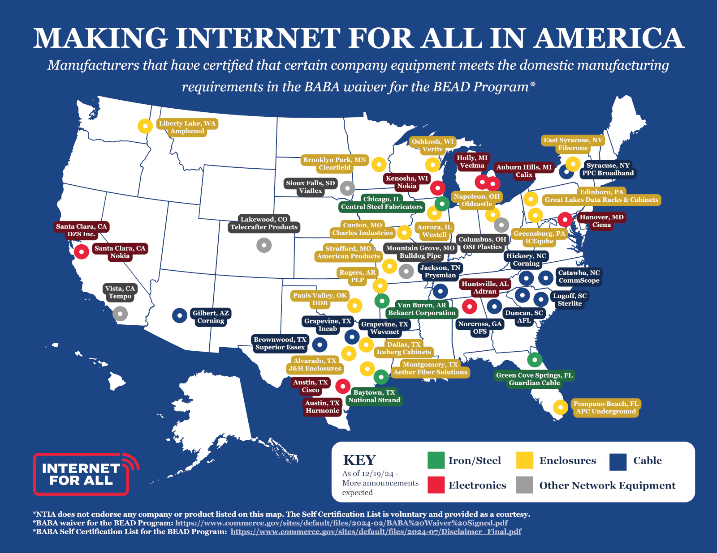
Potential effects on FTTP broadband equipment vendors serving the
US market
Many broadband vendors are increasingly focusing on opportunities in the US, partially spurred by the Broadband Equity and Development Program (BEAD).
BEAD funding comes with strict Build America, Buy America (BABA) compliance requirements. This means eligible equipment must be manufactured or assembled in the US or contain a required percentage of US-made components.
In response, most broadband access equipment vendors serving US clients have shifted key production lines to the US:
  Some vendors have relocated entire production operations.
  Others have moved only enough capacity to meet BEAD-related demand due to the higher costs associated with US manufacturing and labor.
However, many sub-components still need to be imported, which can
  Increase overall equipment pricing.
  Introduce supply chain uncertainties tied to trade policies or tariff changes.
Source: NTIA

Slide 4
Potential tariff implications and the trickle-down effect
FTTP investment in long term in nature. Effects of tariffs by service providers could include:
  Postpone imminent projects until there is better visibility on the likely outlook.
  Scale back or delay capex for future builds and/or upgrades.
  Spend the same amount of capex but cover fewer premises due to the cost increases.
  Pass on the costs to subscribers in the form of higher retail prices.
However, 70–80% of build project capex is usually allocated to civil construction costs (e.g., trenching), and much of this cost comes from labor.
  Machinery costs could rise, though, particularly if tariffs impact the price of imported construction equipment or parts. OLT costs represent just a few percent of total FTTP costs per premises passed, but these costs could also increase.
  In the longer run, labor costs may also increase, as workers may demand higher wages to compensate for the broader economic effects of inflation and tariffs on goods and services.
Higher mfg. costs due to BABA
Higher priced imported sub-components
Potential capex increases place financial pressure on operator projects
Operator may increase subscriber fees and/or delay service expansion/ upgrade
Vendor may pass some or all increased prices of goods on to operators

