Slide 1
City of Philadelphia
Office of Innovation and Technology
Digital Inclusion Programs
May 2025

Slide 2


01
02
03
04
05
Digital EquityPHL
Digital Literacy Alliance
Cross-institutional grantmaking group to seed innovation in the digital equity space.
Digital Navigator Network
1:1 remote or in-person support to households for access and use of technology.
Dial 2-1-1 to make an appointment with a Digital Navigator.
PHLConnectED
Program providing free internet and digital access resources for pre-K-12 families in need.
Device Distribution
Distributing laptops to residents in need.
Deploying computers in Rec Centers in every council district
Philly Free Wi-Fi
Lighting up free public Wi-Fi at over 180 parks and recreation facilities.
To find a location, go to the Philly Free Wi-Fi Finder
Office of Innovation & Technology
For More Information: https://www.phila.gov/programs/digitalequityphl/

Slide 3




Free and low-cost internet promotion and enrollment support. Free T-Mobile Hotspots for eligible Pre-K-12 Households
Local education agency partnerships to push communications directly to parents and students
PHLConnectED
Pre-K-12
Internet Access
211 hotline as a household entry point to access digital resources and schedule a digital navigation appointment
1-on-1 digital navigation services offered in-person and remotely for households to determine the best internet access solutions

Slide 4
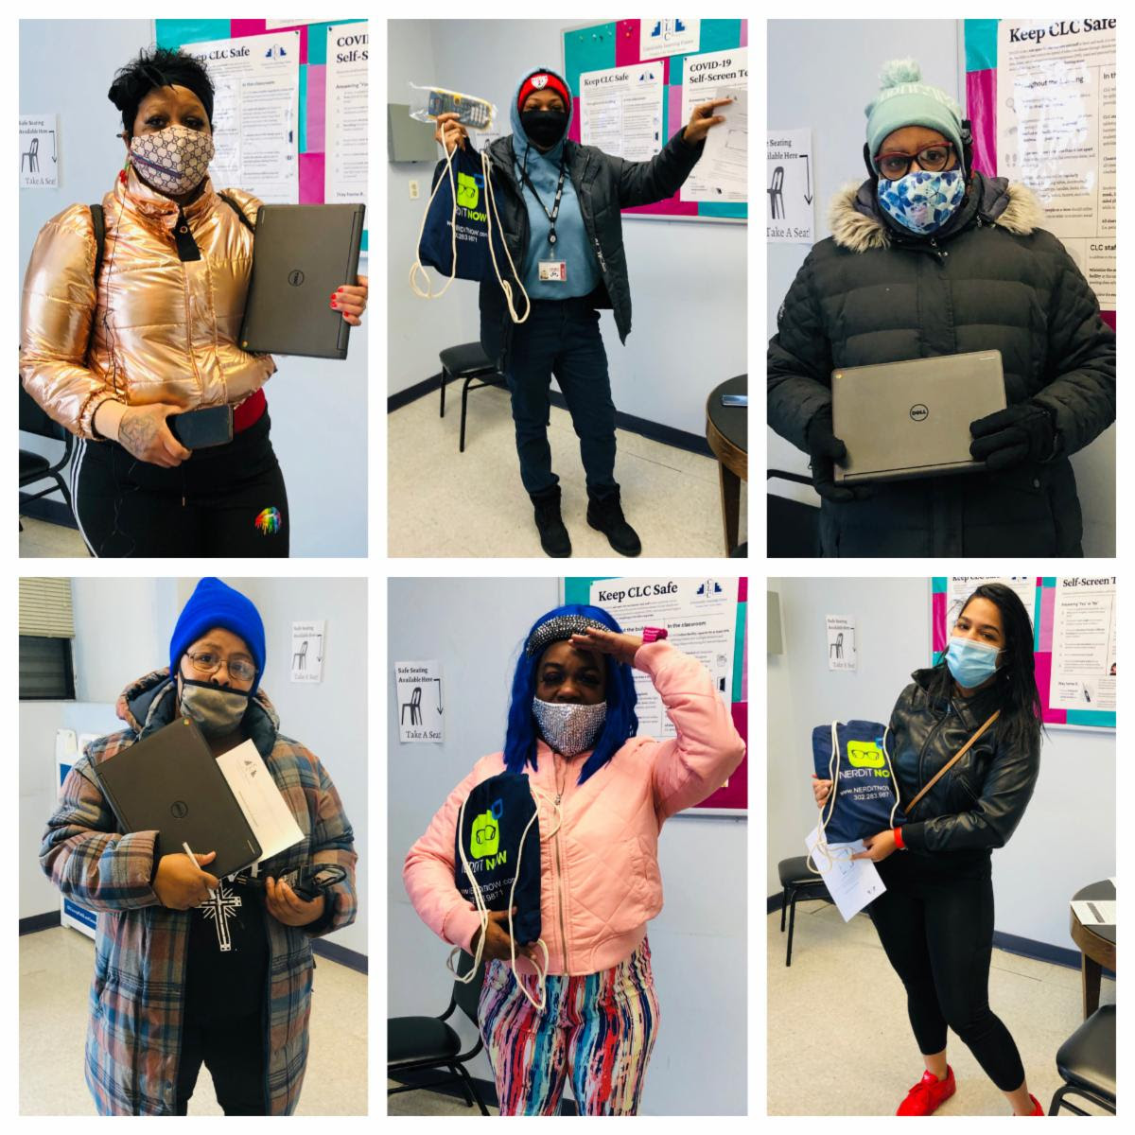
        A “Digital Navigator” acts as a digital support staff who provides remote or in-person one-to-one dedicated support to households around accessing and using technology.
QUICK NUMBERS
6000+ unique clients since 2020
1330+ clients assisted with getting a device
650+ helped with internet access
730+ enrolled in digital skills classes
3000+ unique clients in FY24
  Dial 2-1-1
  to schedule a one-on-one appointment with a Digital Navigator.
The City of Philadelphia
Digital Navigator Network

Slide 5
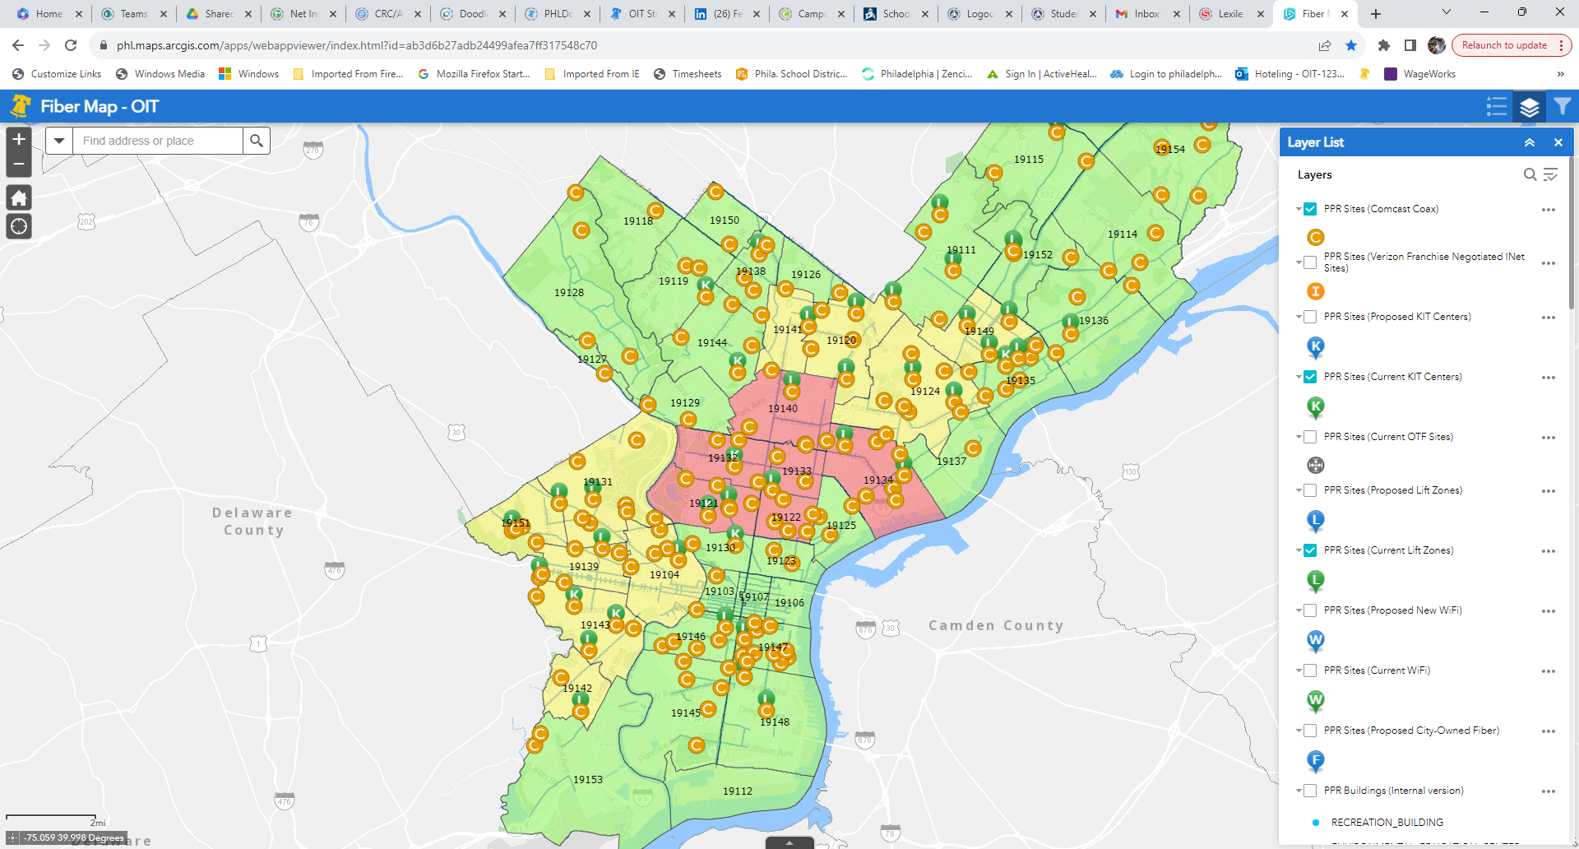
City enables every Recreation Center to be a “Digital Anchor Institution” with a fiber network and ubiquitous Wi-Fi
Within the next 2 years, over PPR locations will be provided with:
1GB symmetrical high-speed internet
Meraki Wi-fi installed
2 strands of dark fiber for smart city and other internal uses
How Philly Free Wi-Fi Finder and Dashboard Works
Find a site with public Wi-Fi and computer services near you
See which sites have been lit up and which are still coming
Search by zip or council district
Overlay with census data
Philly
Free Wi-Fi
Current Status
78 sites have been activated since Oct. 2024 | 132 sites in total now have public Wi-Fi
https://www.phila.gov/wifi/

Slide 6
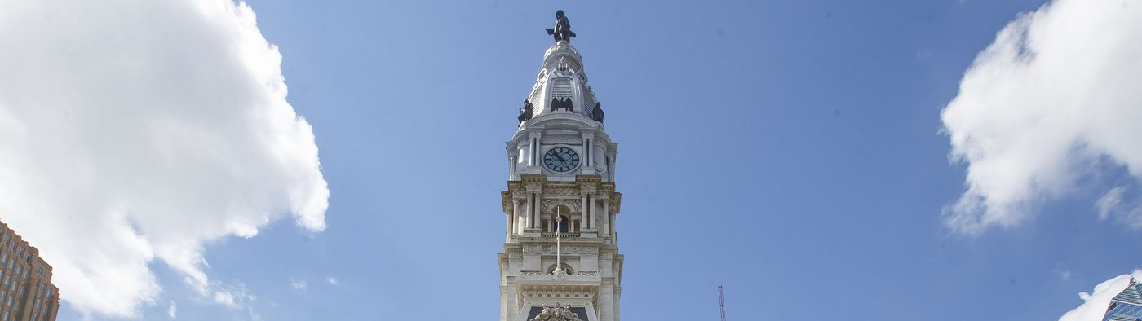
OIT will work with a community partner organization to host a one-time laptop giveaway event in every council district. Pre-registered residents who meet the low-income eligibility requirements will receive a laptop and access to digital skills to empower them to Power Up their lives.
10
500
City Digital Navigator Network on-site
Online Safety Workshop
Digital Skills Class referrals and enrollments
Council Districts
Laptops

