Slide 1
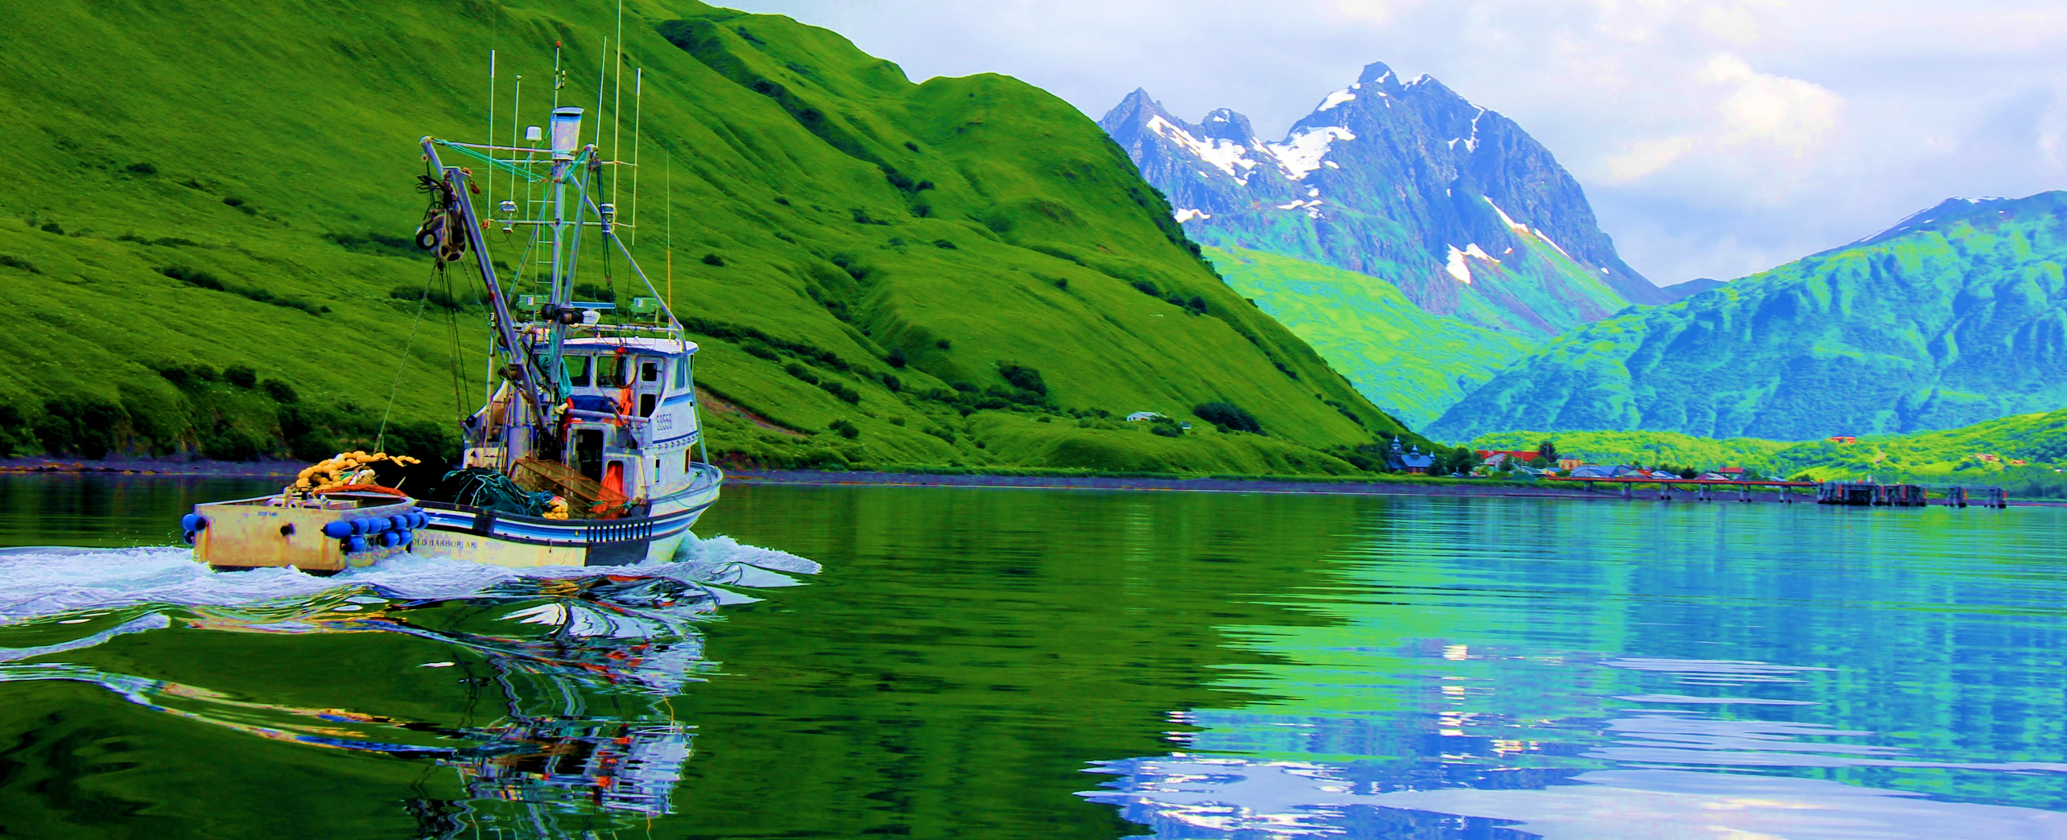
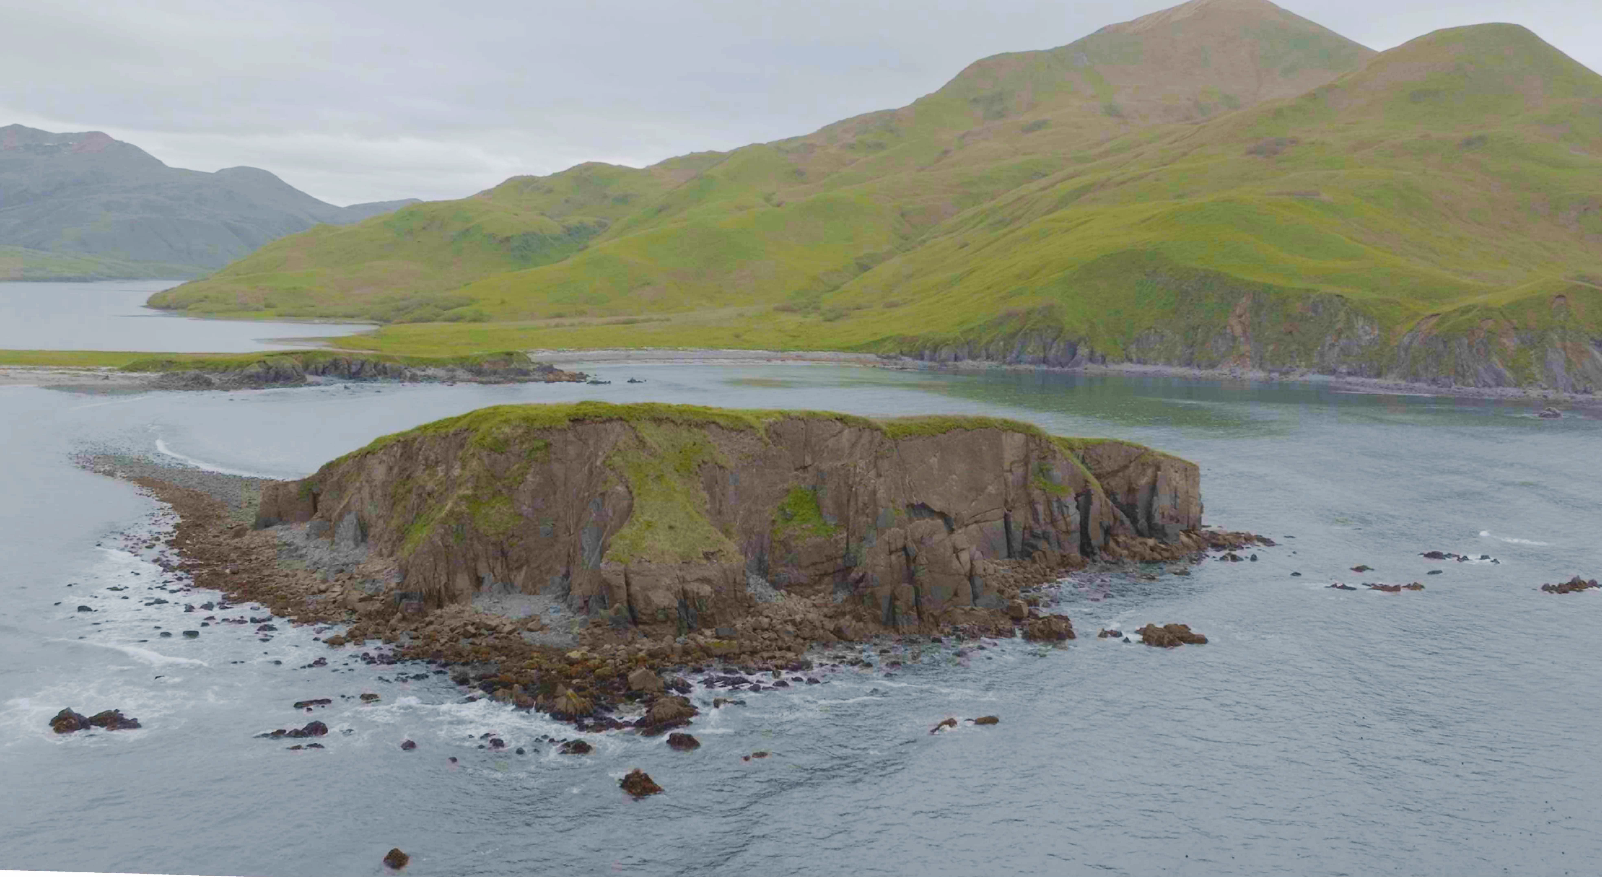
Project Nunapet

Slide 2
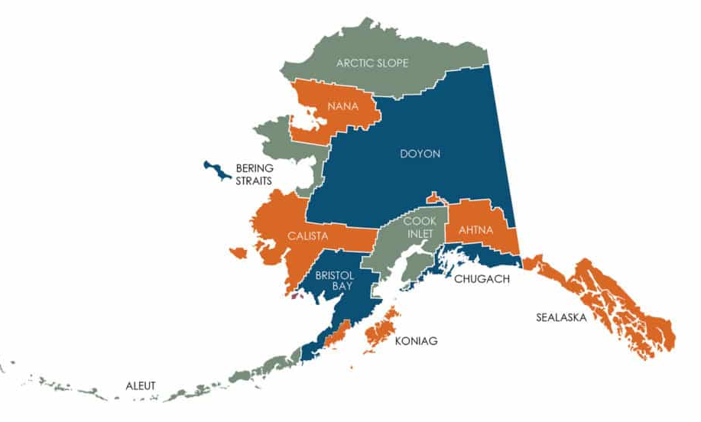
Alaska Native Corporations

Slide 3
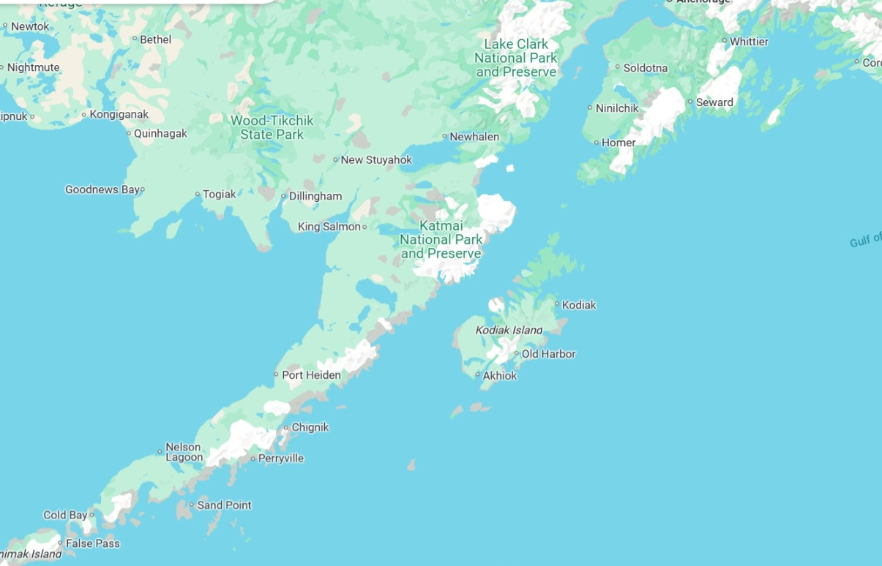
Project Nunapet

Slide 4
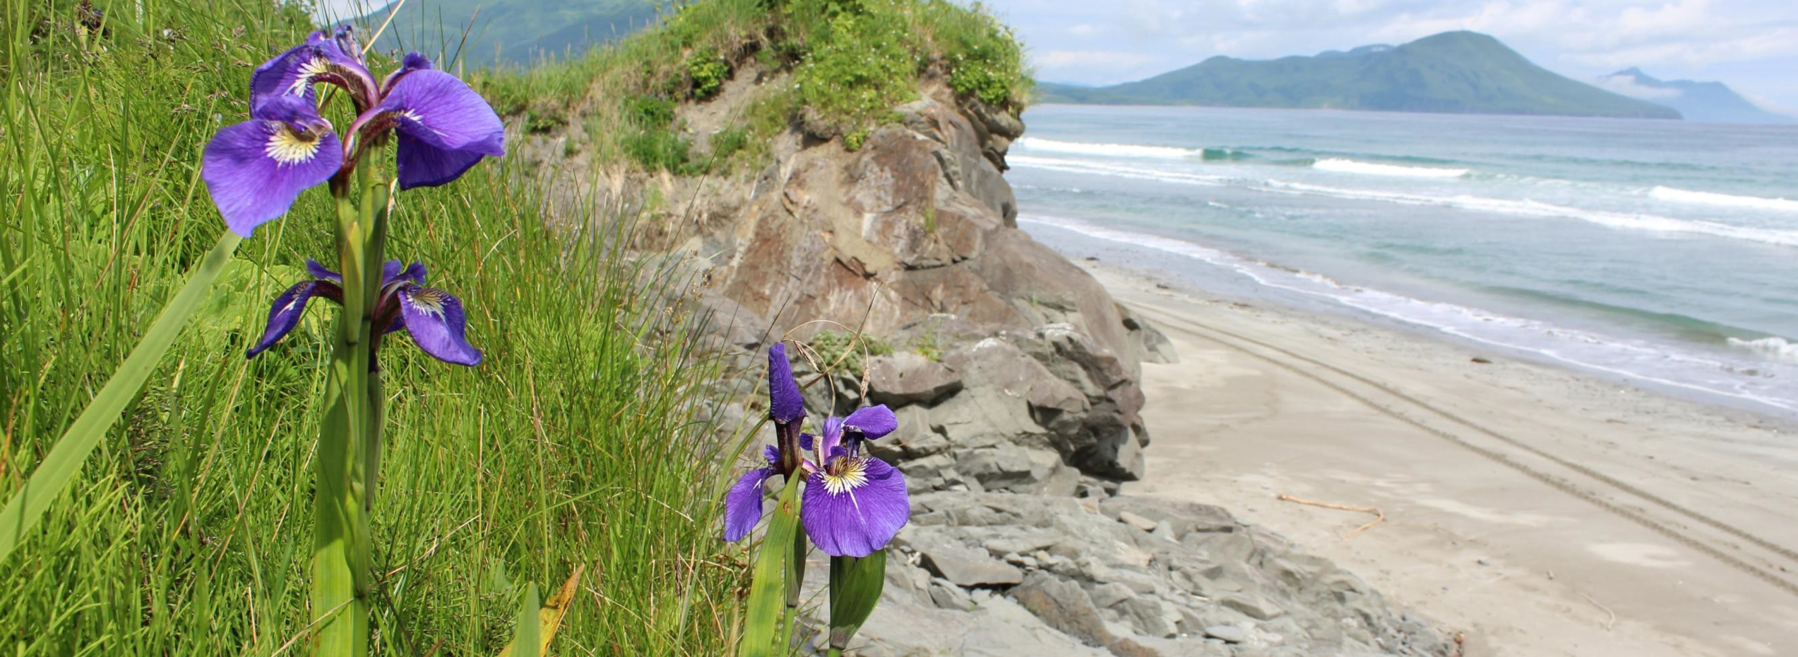
Old Harbor, Alaska. Remote. Rugged. Beautiful.

Slide 5
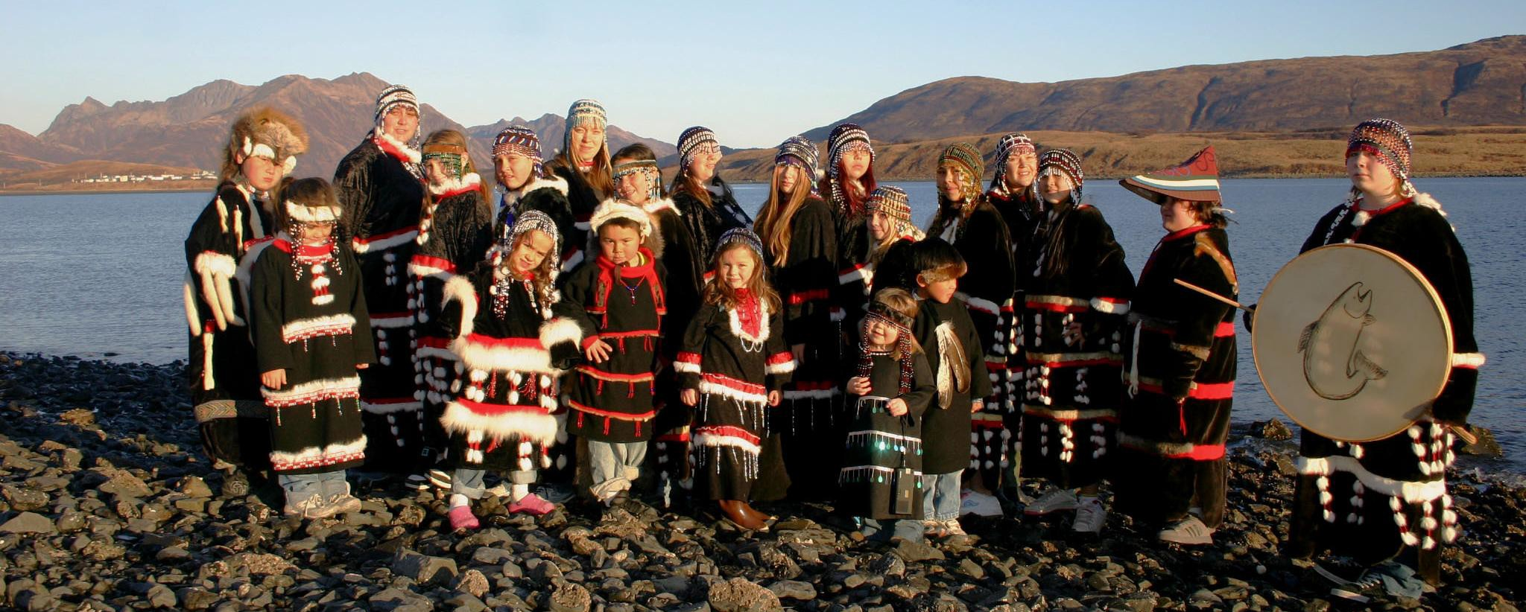
Sugpiaq/Alutiiq
The first people of Kodiak Archipelago

Slide 6
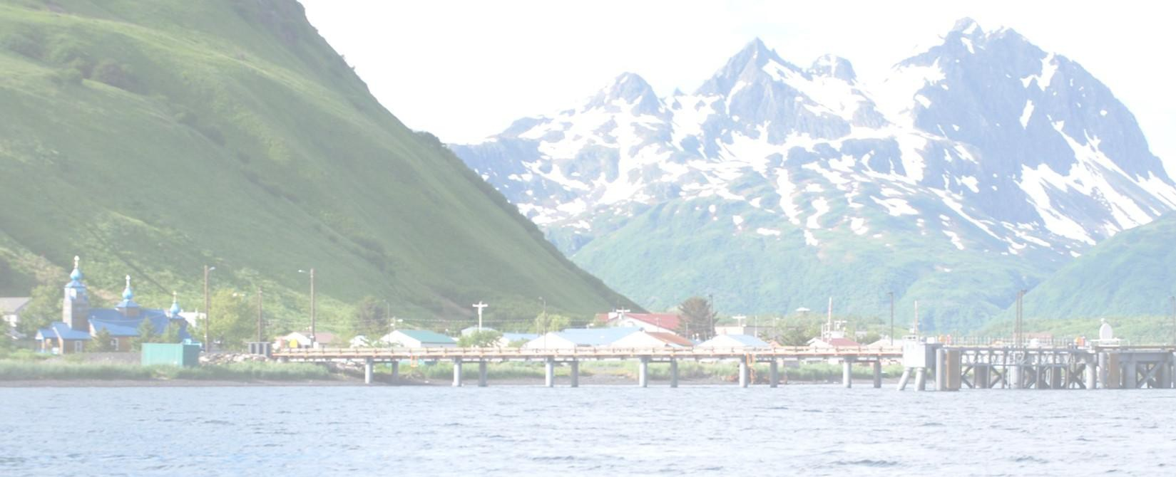
Nunapet = self sufficiency
Reasonably priced true broadband
Creates economic development opportunities
Hydro-electric project provides affordable power
Expanded airport improves safety and access

Slide 7
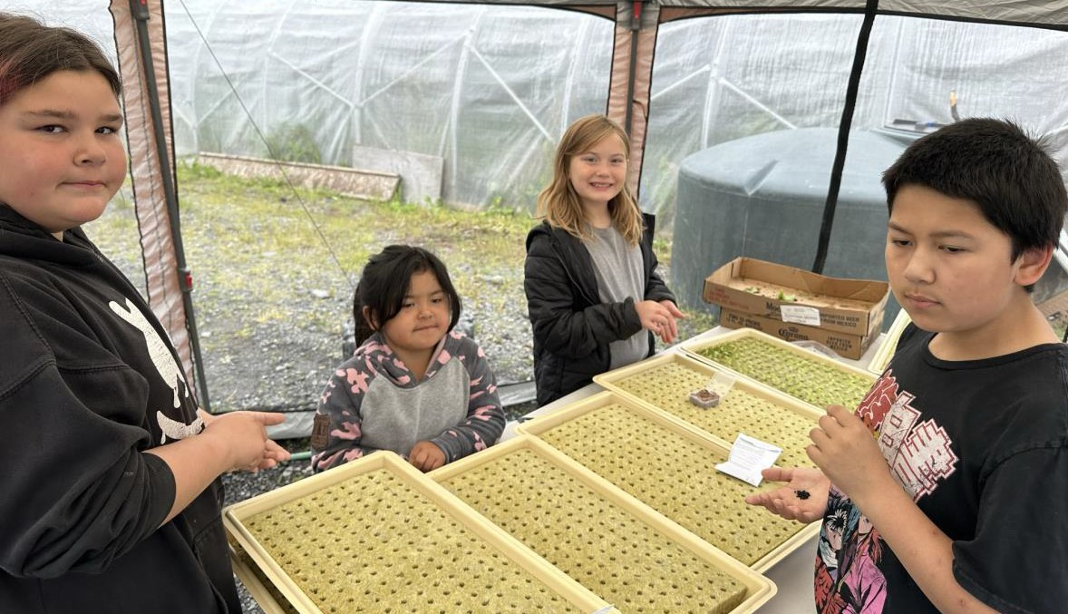
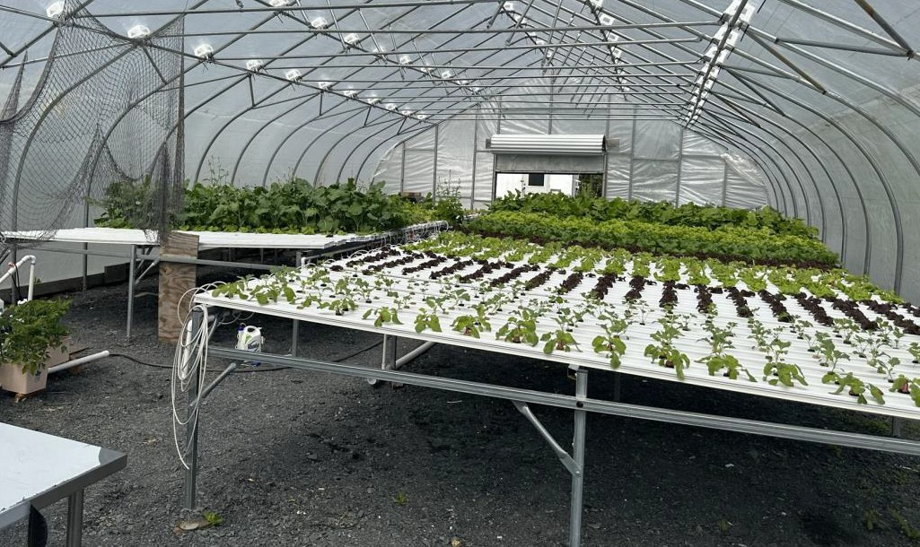

Slide 8
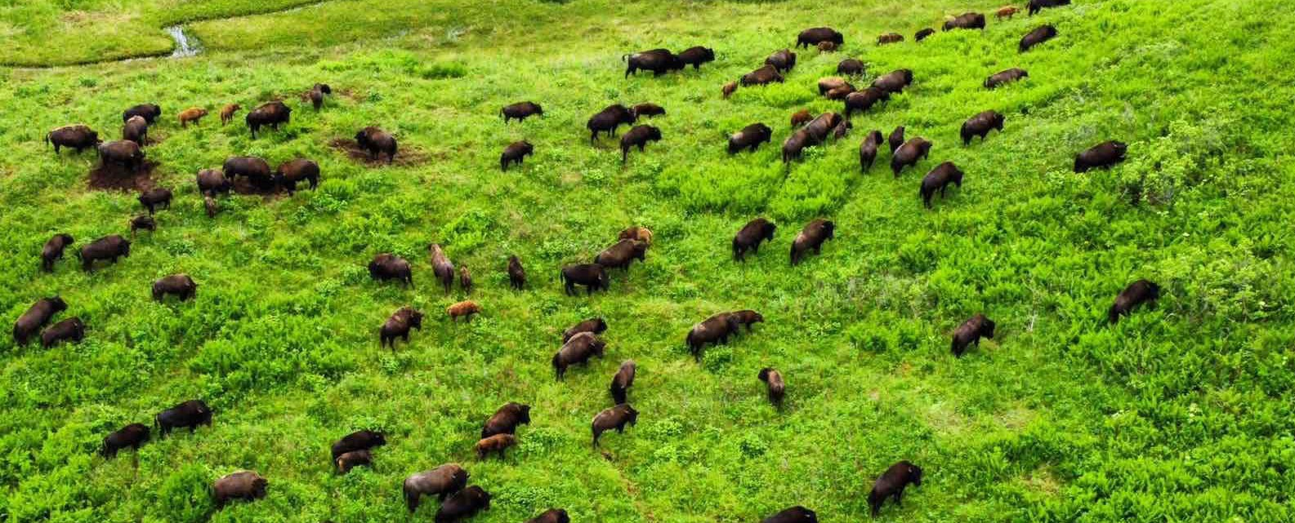
Sitkalidak Bison Herd

