Slide 1
Agentic AI & the Future of Fiber: Powering Scalable, Resilient, & Intelligent Networks
Episode 24

Slide 2
Thank you to our Fiber for Breakfast Sponsor!
Platinum Sponsor

Slide 3
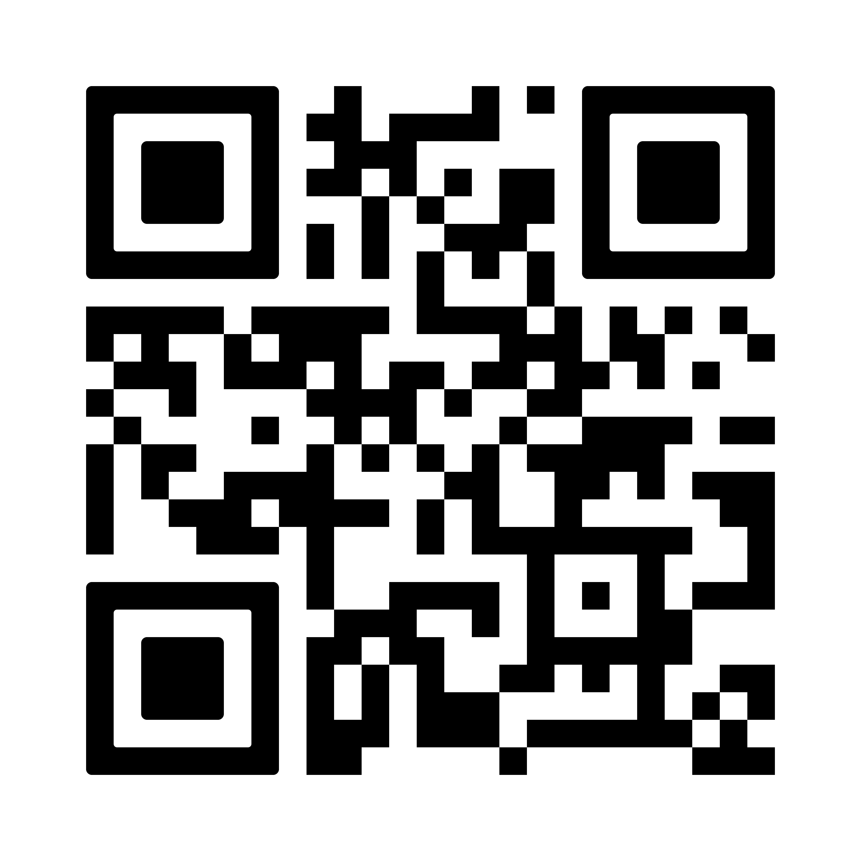
FIBER CONNECT 2025
June 1-4, 2025
Gaylord Opryland Resort & Convention Center
Nashville, TN
Save the Date!

Slide 4
2025 Regional Fiber Connect Locations
Anchorage, Alaska - July 17 | Fiber and Fixed Wireless
Toronto, Canada - August 19 | Fibre Economics
Spokane, Washington - September 16 |Urban & Suburban Digital Divide
Scottsdale, Arizona - October 16 | Tribal Broadband
Kansas City, Missouri - November 11 | Demand Drivers
Contact Lucy Green (lgreen@fiberbroadband.org) for Exhibit and Sponsorship Opportunities
Notes:
Links for Chat
Fiber Connect 2025 – Save the date!
https://fiberbroadband.org/event/fiber-connect-2025/

Slide 5
Ron Westfall
Analyst in Residence

Slide 6
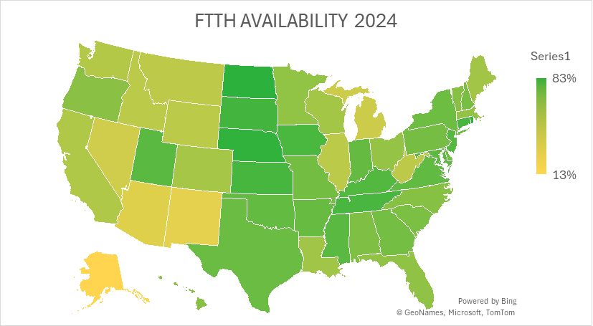

Slide 7
Why Agentic AI is Vital to the Fiber Industry: Fiber for Breakfast June 11, 2025 - Episode 24
Ron Westfall
Analyst-in-Residence

Slide 8
What is Agentic AI?
Benefits
Ability to act autonomously
Make real-time decisions
Engage with external systems, tools, or humans
Traditional AI often follows predefined scripts or rules
Boosts efficiency
AI models access relevant data in real time
Improve performance over time based on experience or feedback
Ready to Skyrocket: $7.3B in 2025 w/ CAGR of 41.48% reaching $41.3B by 2030 (Mordor Intelligence)

Slide 9
Why is Fiber Industry Ready for Agentic AI?
Key Drivers
Fiber-optic networks require real-time data processing,
Large-scale data transfers & rapid decision-making.
WW FTTH connections to reach 1.7B by 2027
Integral to edge compute for real-time applications (e.g., IoT, AR/VR, digital twins)
Global investment in fiber infrastructure to reach $200B by 2026
Security & Data Integrity: Critical for agentic AI handling sensitive data
Sectors like healthcare, finance & defense

Slide 10
Automation Considerations
Automate Complex Network Management Tasks
Real-time traffic optimization
Fault Detection
Predictive Maintenance
AI-driven Orchestration
Reduce manual interventions
Improve operational efficiency
Minimize downtime
Meets Topmost Fiber Needs
Assure high reliability
Fulfill workload optimization goals
Scale escalating bandwidth demands

Slide 11
Why Fiber Networks Gain Advantages
Addresses resource-intensive nature of fiber network deployments
Streamlines intricate processes through AFND, GIS data, customer demand & regulations
Optimize routes and minimize cable lengths
Uses AI agents bots embedded in fiber management dashboards
Conversational interfaces can accelerate real-time insights and troubleshooting
Real-world solutions: Nokia Digital Ops Center uses Agentic AI; ADTRAN’s AI Network Cloud; Cisco AgenticOps

Slide 12
Scalability and Sustainability
Enables scalable infrastructure - intelligent automation & dynamic resource allocation
Optimize long-haul fiber connectivity between DCs
Expand capability w/o geo constraints
Improve energy usage
Predict environmental impacts and adapting strategies in real-time
Supports sustainable decision-making & accelerates net-zero goal fulfillment
UPS saved $300M annually by eliminating 100 miles of driving, reducing CO₂

Slide 13
Proactive Maintenance and Resilience
Proactive detection of anomalies and potential failures
Fiber cuts
Environmental factors
Assess data readiness and infrastructure
Evaluate data quality
Invest in infrastructure
Real-time data analysis
Implement robust security measures
Trigger restoration processes, pre-empt issue escalation
Ensure uninterrupted service
Monitor and evaluate AI performance
Set KPIs to assess effectiveness
Continuous improvement

Slide 14
Top Takeaways
Agentic AI boosts automation and deployment optimization
Improves reliability and supports sustainability
Strategic alignment is key to AI success

Slide 16
QUESTIONS?
Notes:
Seed Questions:
1.
Registrant questions:
1.

Slide 17
UP NEXT
Fiber for Breakfast Week 25
Wednesday, June 18th, 2025, at 10 AM Eastern
Gene Crusie CEO
Surf Internet
Register for upcoming episodes and view recordings (FBA members only) on the Fiber for Breakfast page on the Events tab of the FBA website.
For information about FBA, contact membership@fiberbroadband.org.
Notes:
Links for chat:
Don’t miss out on next week’s Fiber for Breakfast!
Fiber for Breakfast Series Registration: Opt-In for 2024 Season – Fiber Broadband Association

