Slide 1
Fiber Builds Value: Turning Connectivity into Revenue Along Michigan’s I-75 Corridor
Episode 26

Slide 2
Thank you to our Fiber for Breakfast Sponsor!
Platinum Sponsor

Slide 3
2025 Regional Fiber Connect Locations
Anchorage, Alaska - July 17 | Fiber and Fixed Wireless
Toronto, Canada - August 19 | Fibre Economics
Spokane, Washington - September 16 |Urban & Suburban Digital Divide
Scottsdale, Arizona - October 16 | Tribal Broadband
Kansas City, Missouri - November 11 | Demand Drivers
Contact Lucy Green (lgreen@fiberbroadband.org) for Exhibit and Sponsorship Opportunities
Notes:
Links for Chat
Fiber Connect 2025 – Save the date!
https://fiberbroadband.org/event/fiber-connect-2025/

Slide 4
Chuck Irvin
Chief Revenue Officer

Slide 5
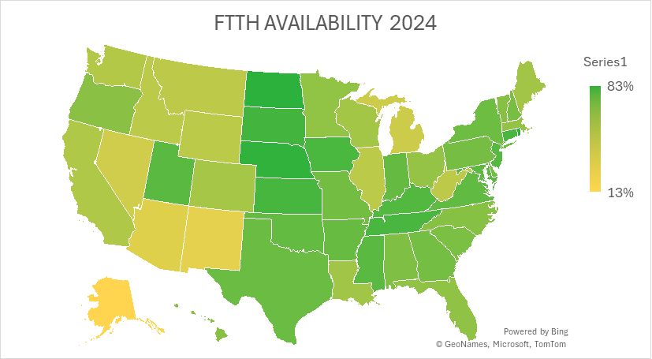

Slide 6
Fiber for Breakfast Podcast Chuck Irvin – Chief Revenue Officer

Slide 7
OUR MISSION
BUILDING NETWORK
TO MAKE MICHIGAN COMMUNITIES & BUSINESSES
THE BEST CONNECTED ON THE PLANET.
Notes:
300+ Fiber Miles Per Year
2-3 Lit Buildings Per Day
11 Fiber Construction Crews
All in House
We have been involved in discussions and projects
Transition: We are working with Auto OEM’s & Suppliers on their AV projects. This is what we are seeing…

Slide 8
KEY
NUMBERS
MICHIGAN FOCUSED
4
100k
40+
9th
4.8k+
3.6k+
120+
Carrier-Neutral Data Centers
Sq. Ft. Data Center
Space
Carriers &
IP Providers
Largest NA
Internet Exchange
Fiber Route Miles
Fiber Lit Buildings
Carrier Connection Sites
Notes:
Key numbers
Here you will see some key numbers that we’re proud of here at 123NET. These numbers help tell that story of our scale and overall scope of growth
I’ll just touch on a few of these.
We run the 10th largest internet exchange here in north America and this is something that didn’t exists 5 year ago.
We currently have over 3500 fiber lit building in the state
What I'd like to do now is give you a quick overview of our network

Slide 9
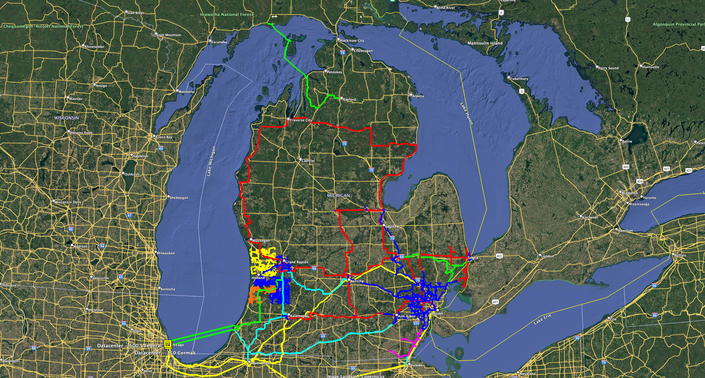

Slide 10
Enhancing MDU Properties with Seamless Fiber Connectivity
+8%
Rental Value
+11%
NOI per Unit
+2.8%
Property Value
SAVE MONEY
✅ High Demand Residents want fiber and are willing to pay
🚀 Fast Impact See results within months, not years
💸 Often $0 Upfront Deployment typically costs ownership nothing

Slide 11
QUESTIONS?
Notes:
Seed Questions:
1.
Registrant questions:
1.

Slide 12
UP NEXT
Fiber for Breakfast Week 27
Wednesday, July 2nd, 2025, at 10 AM Eastern
Special Guest:
Anna M. Gomez
Commissioner
Federal Communications Commission
Register for upcoming episodes and view recordings (FBA members only) on the Fiber for Breakfast page on the Events tab of the FBA website.
For information about FBA, contact membership@fiberbroadband.org.
Notes:
Links for chat:
Don’t miss out on next week’s Fiber for Breakfast!
Fiber for Breakfast Series Registration: Opt-In for 2024 Season – Fiber Broadband Association

