Slide 1

Bridging the Divide in the Mountain State: Citynet’s Role in Rural Broadband Expansion
Episode 31

Slide 2

Thank you to our Fiber for Breakfast Sponsor!
Platinum Sponsor

Slide 3
2025 Regional Fiber Connect Locations
Toronto, Canada - August 19 | Fibre Economics
Spokane, Washington - September 16 |Urban & Suburban Digital Divide
Scottsdale, Arizona - October 16 | Tribal Broadband
Kansas City, Missouri - November 11 | Demand Drivers
Contact Lucy Green (lgreen@fiberbroadband.org) for Exhibit and Sponsorship Opportunities
Notes:
Links for Chat
Fiber Connect 2025 – Save the date!
https://fiberbroadband.org/event/fiber-connect-2025/

Slide 4




Gaurav Juneja
Chief Operating Officer

Slide 5



Meet
Jim Martin & Citynet
ABOUT CITYNET
Founded in 1994. Specializes in delivering high-speed fiber-optic broadband, especially to rural and underserved areas.
JIM MARTIN
EXPERTISE
Recognized for technical excellence in fiber-to-the-premises (FTTP) deployments.
President & CEO of Citynet, a leading
West Virginia-based broadband provider
Mission-Driven
Partners with local governments to expand access to affordable, reliable internet and help close the digital divide.

Slide 6
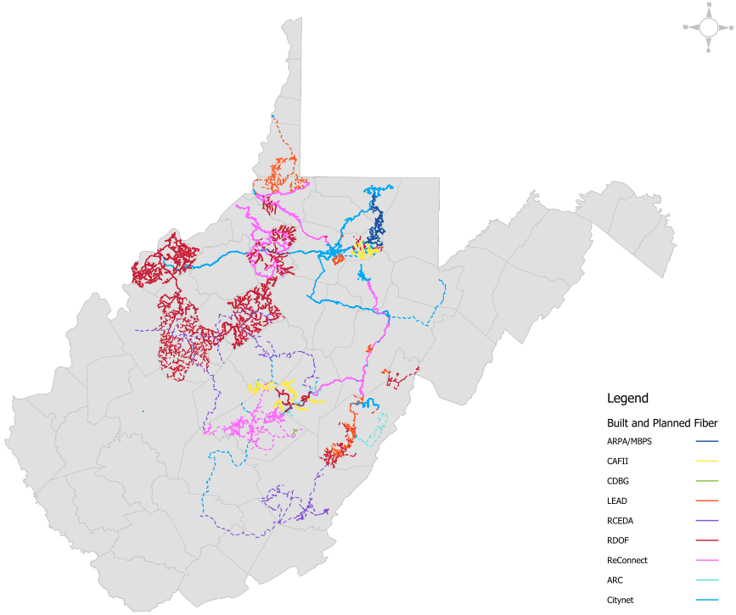
Public/Private Partnerships

Slide 7
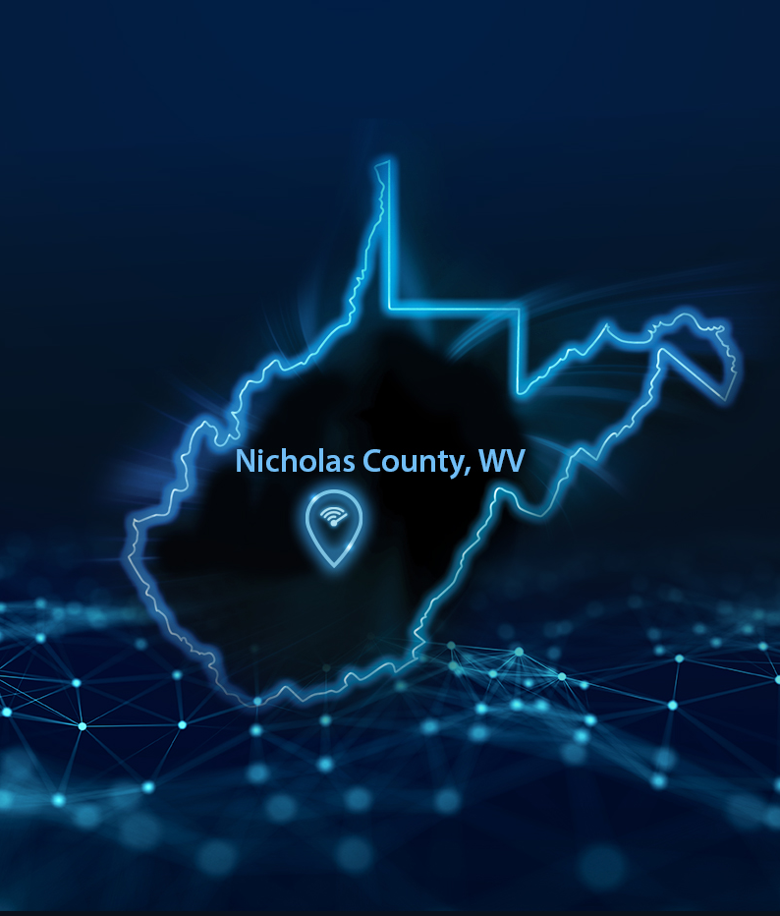
Nicholas County, WV
Demographics & Connectivity Challenges
POPULATION
Approximately 24,600 residents (2023 est.), with a largely rural makeup.
ECONOMIC PROFILE
Poverty rate near 20%, notably higher than the national average (~11.5%).
CONNECTIVITY GAPS
Many homes and businesses lack access to 100 Mbps download / 20 Mbps upload speeds, a critical barrier to full digital participation.
TOPOGRAPHY & ACCESS BARRIERS
Rugged terrain, low population density, and affordability challenges limit broadband expansion and adoption.
CURRENT INFRASTRUCTURE
Sparse fiber deployment; many rely on outdated DSL or satellite, affecting education, healthcare, remote work, and economic growth.

Slide 8

Nicholas County ReConnect Award
AWARD ANNOUNCEMENT
In January 2025, the Nicholas County Commission received a $24.87 million ReConnect award, structured as 50% loan / 50% grant.
SMART FINANCING
The loan is revenue-based and repaid through project earnings, with no added cost to residents.
PROJECT PARTNERS
Nicholas County Commission
Citynet (ISP)
Region 4 Planning & Development Council
USDA Rural Partners Network
COMMUNITY IMPACT
Will connect ~6,000 residents, 2,392 addresses, 118 farms, 41 businesses, and critical institutions like schools and fire stations.
LONG-TERM BENEFITS
Unlocks access to education, healthcare, and economic opportunities across the county.

Slide 9
West Virginia’s Broadband Challenge
Pole Attachments are the #1 issue for broadband expansion in WV.
WV Public Service Commission Active Cases
https://www.psc.state.wv.us/
Pole Attachment Task Force
Case No. 24-0703-T-E-CTV-GI
Comcast vs AEP
CASE NO. 25-0463-CTV-E-POLE
DQE, LLC’s Petition for Rulemaking
Case No. 25-0350-T-P
Citynet vs FirstEnergy & Frontier
Case No. 25-0640-T-E-POLE
JIM MARTIN
President & CEO of Citynet, a leading
West Virginia-based broadband provider

Slide 10


Slide 11
UP NEXT
Fiber for Breakfast Week 32
Wednesday, August 6th, 2025, at 10 AM Eastern
Driving Connections: Local Lessons from the Road to Broadband Expansion
Special Guest:
Andrew Butcher
President
Maine Connectivity Authority
Register for upcoming episodes and view recordings (FBA members only) on the Fiber for Breakfast page on the Events tab of the FBA website.
For information about FBA, contact membership@fiberbroadband.org.
Notes:
Links for chat:
Don’t miss out on next week’s Fiber for Breakfast!
Fiber for Breakfast Series Registration: Opt-In for 2024 Season – Fiber Broadband Association

