Slide 1

Aging in Place: Powered by Fiber
Episode 39

Slide 2


Thank you to our Fiber for Breakfast Sponsor!
Platinum Sponsors

Slide 3
2025 Regional Fiber Connect Locations
Scottsdale, Arizona - October 16 | Tribal Broadband
Kansas City, Missouri - November 11 | Demand Drivers
Contact Lucy Green (lgreen@fiberbroadband.org) for Exhibit and Sponsorship Opportunities
Notes:
Links for Chat
Fiber Connect 2025 – Save the date!
https://fiberbroadband.org/event/fiber-connect-2025/

Slide 4

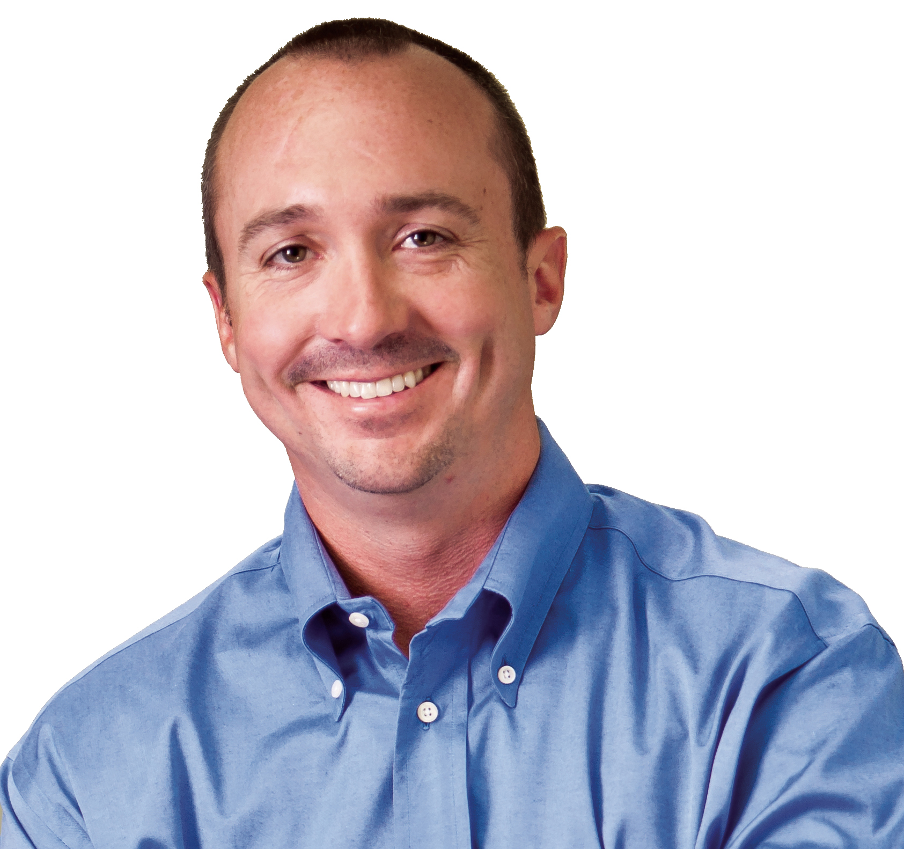
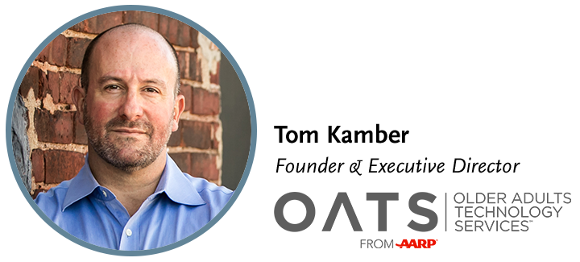

Gaurav Juneja
Chief Operating Officer

Slide 5

Aging in Place: Powered by Fiber
Tom Kamber, Executive Director
Older Adults Technology Services (OATS) from AARP

Slide 6
2004
22% of Americans
65 and older use the internet
Pew Research Center

Slide 7
Connected Aging is Transformational Aging

Slide 8
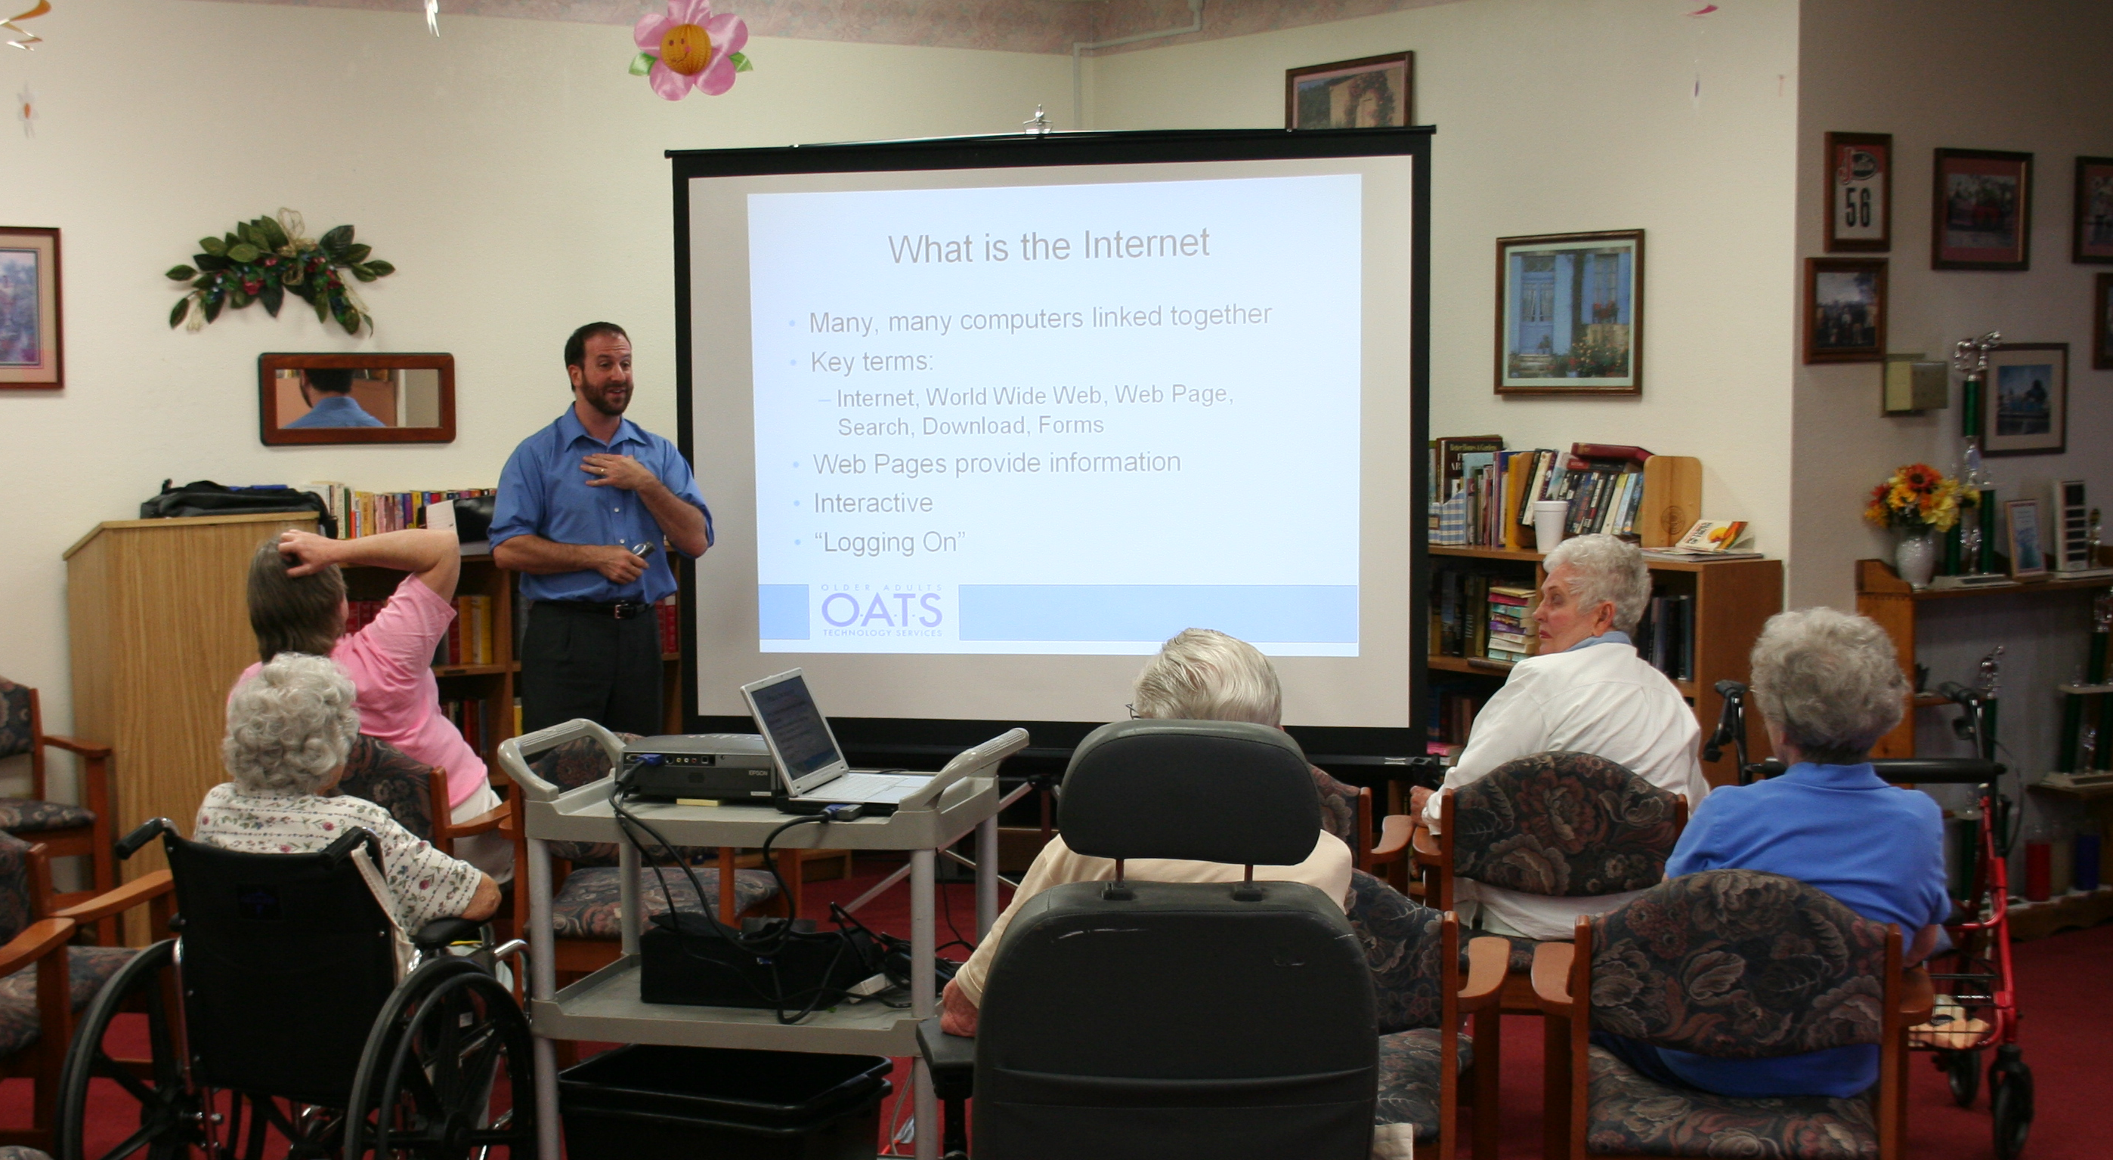
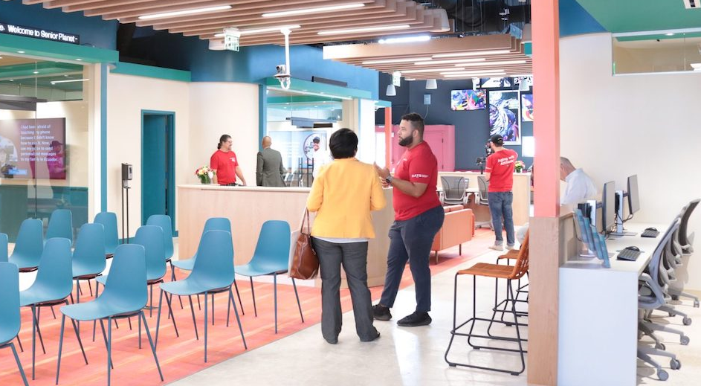
Changing Models
of Community

Slide 9
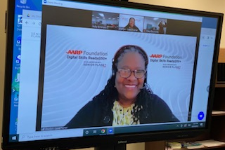
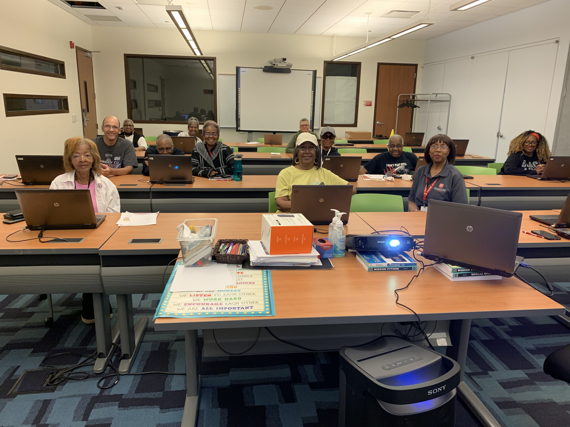
New Approaches to Skills Development

Slide 10
Stronger Social Connection

Slide 11
2023
Approximately 19 million U.S. adults age 65 and older do not have a home wireline internet subscription
Pew Research Center

Slide 12
UP NEXT
Fiber for Breakfast Week 40
Wednesday, October 1st, 2025, at 10 AM Eastern
The Future of Agriculture Grows on Fiber
With Special Guest
Dr. William Aderholdt
Executive Director & Cofounder
Grand Farm
Register for upcoming episodes and view recordings (FBA members only) on the Fiber for Breakfast page on the Events tab of the FBA website.
For information about FBA, contact membership@fiberbroadband.org.
Notes:
Links for chat:
Don’t miss out on next week’s Fiber for Breakfast!
Fiber for Breakfast Series Registration: Opt-In for 2024 Season – Fiber Broadband Association

