Slide 1

Reviewing the Dramatic Changes to Our Lives From the Internet… and Fiber
Episode 44

Slide 2

Thank you to our Fiber for Breakfast Sponsor!
Platinum Sponsor

Slide 3
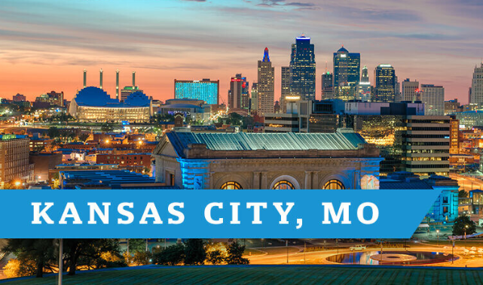
2025 Regional Fiber Connect Locations
Kansas City, Missouri November 11 Demand Drivers
Contact Lucy Green (lgreen@fiberbroadband.org) for Exhibit and Sponsorship Opportunities
Notes:
Thank you for attending today and thank you to . . .
Mike and Imtiaz, and Panduit for sponsoring today’s webinar.
Before we wrap up I want to share a few quick announcements.
Our next Regional Fiber Connect will take place on October 16th in Scottsdale, Arizona. Followed by Kansas City, Missouri on November 11th.
If you are local to either area, please join us. Follow the link in the resources tool for more information and registration details.

Slide 4




Gaurav Juneja
Chief Operating Officer

Slide 5



Encapsulating The
Profound Impact Of The Internet On American Life
Based on 20 Years Of FBA Data
Review of annual FBA/ RVA Broadband Consumer Studies

Slide 6

Vision For The FBA’s Consumer Research
At its founding in 2002, the FBA articulated a foresighted vision for how the Internet would change our way of life in the coming years.
In 2007, the FBA commissioned RVA to begin an annual study of Internet consumers.
To date, those annual consumer studies (2007-2025) represent the longest and most comprehensive body of research about the use and impacts of the Internet in the U.S.

Slide 7
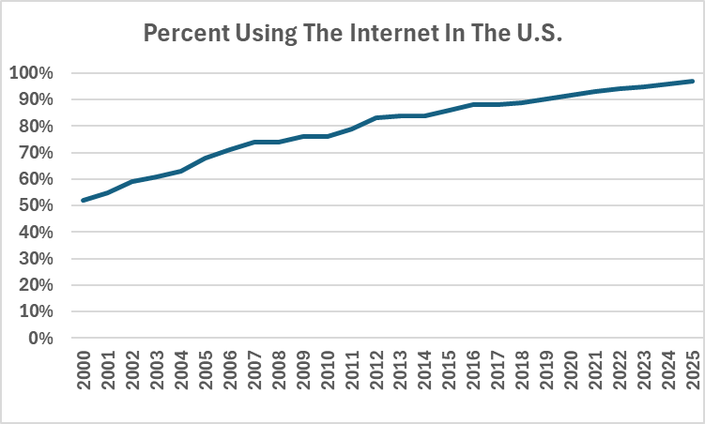

Utilization Of The Internet
PEW studies (A few gaps filled with trends)

Slide 8
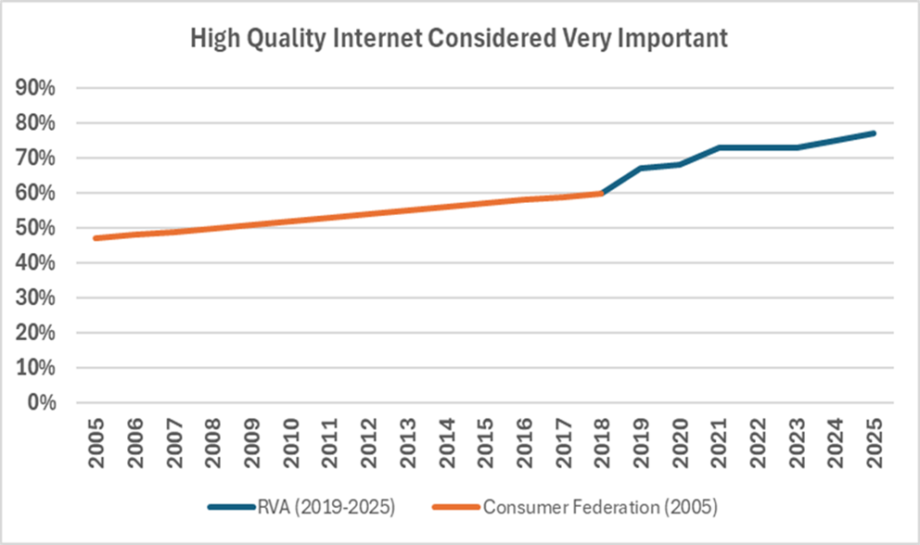

Importance Of The Internet

Slide 9
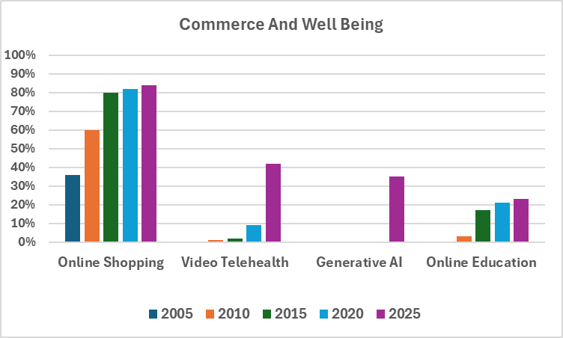
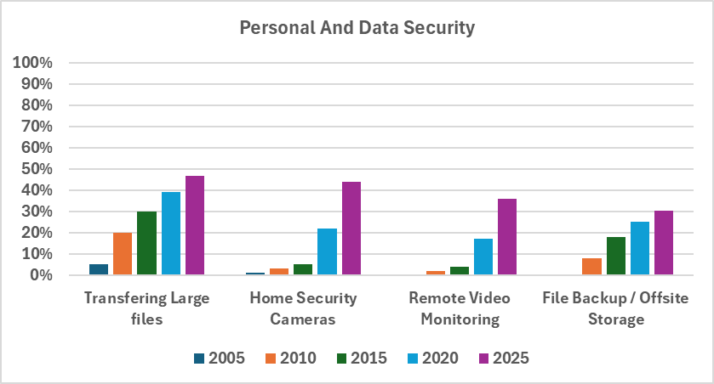
Uses Of The Internet
RVA
RVA
RVA

Slide 10
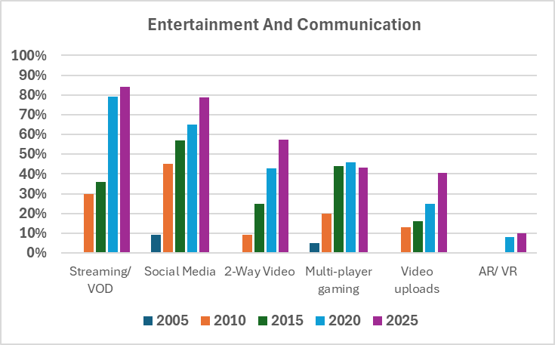
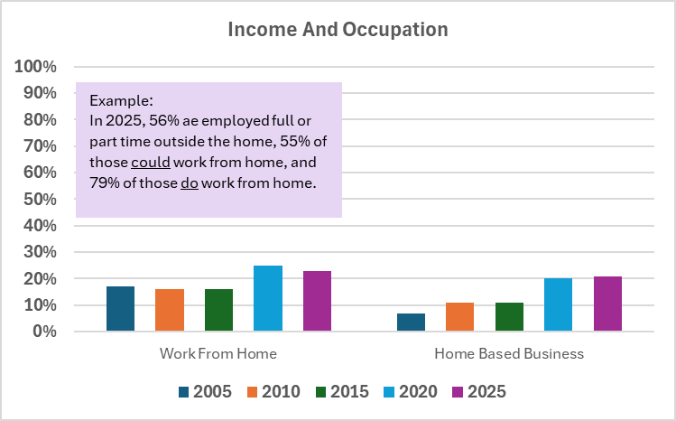
Uses Of The Internet (Cont.)
RVA
RVA

Slide 11
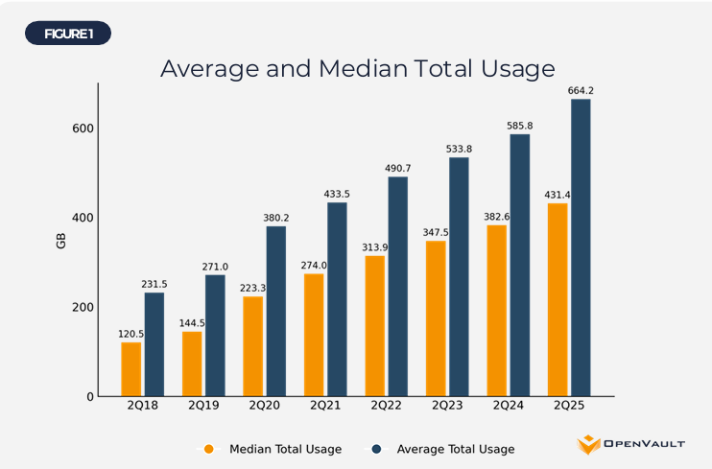
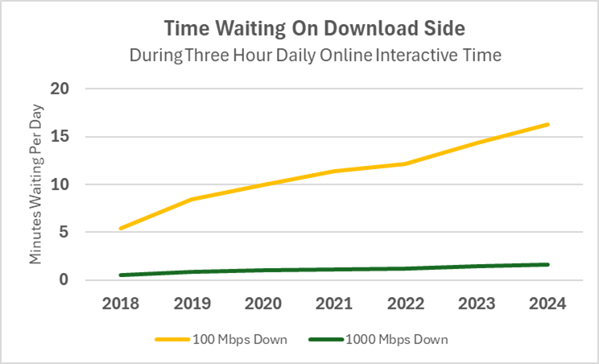
Throughput Of The Internet
RVA

Slide 12
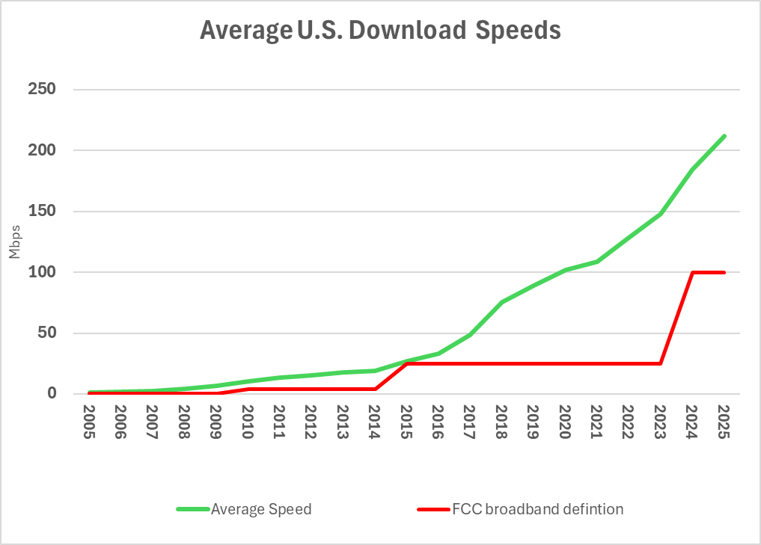
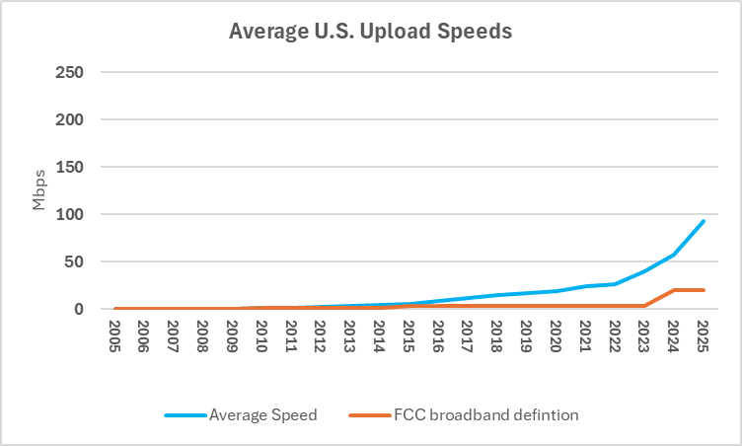

Capability Of The Internet
RVA
RVA

Slide 13
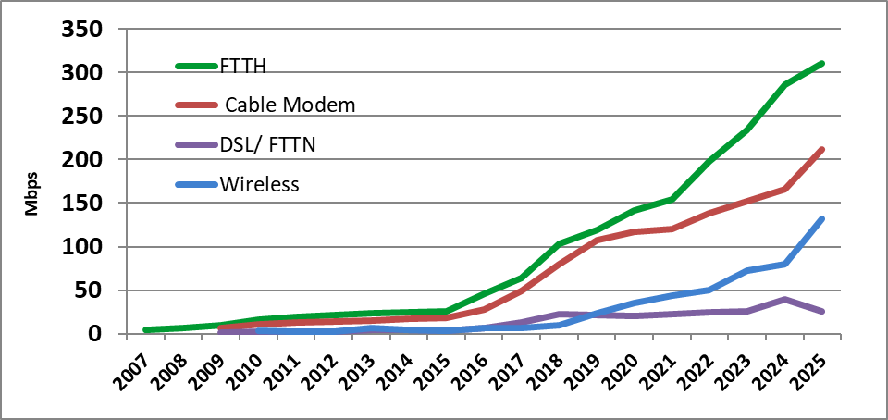
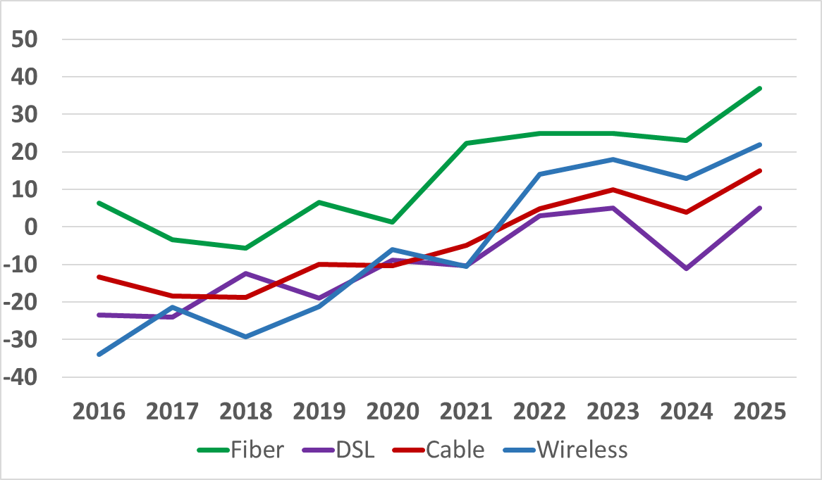
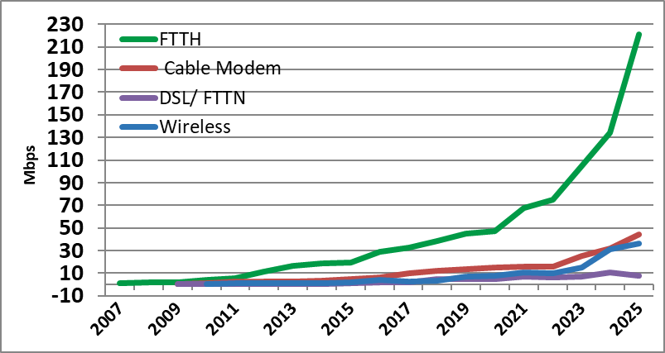
Differentiation Of The Internet
Download Speeds
NPS Scores
RVA
RVA
Upload Speeds
Perceived Best
RVA
RVA

Slide 14
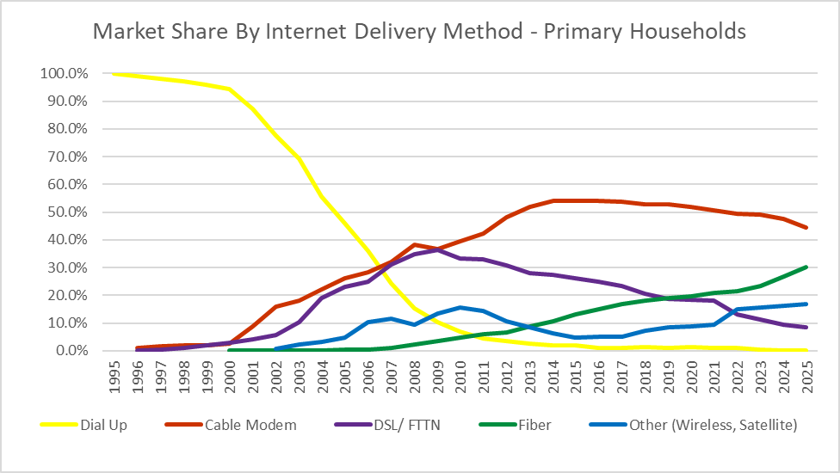
Internet Delivery Market Share
Delivery Method Selected In Last Two Years Where Fiber Is Available*
Market Share: Internet Delivery Methods**
RVA
RVA
*Represents new households, those new to the internet, and those churning because of home move or dissatisfaction. Mobile wireless is included when it is the primary Internet at home.
**Share based on others studies to 2006, FBA/ RVA studies 2007-2025

Slide 15
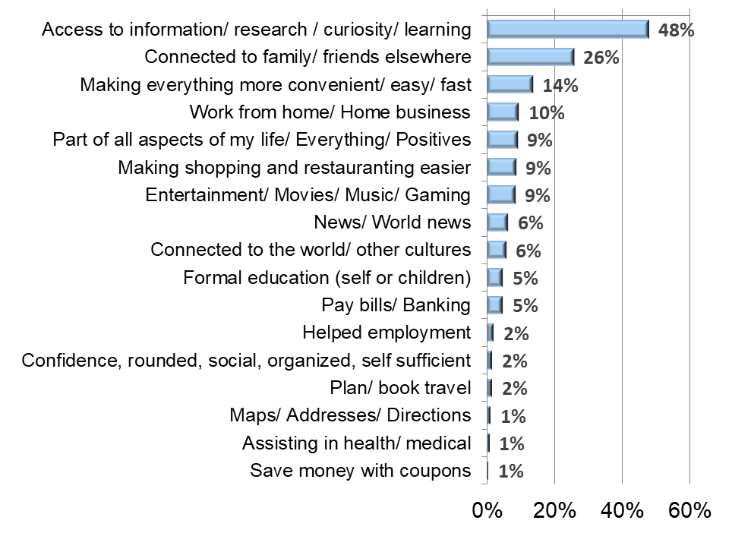
Experieince With he Internet
Life Impacts Of The Internet
Life Impacts Of Internet Overall
How Internet Has Impacted Life: Categorized Open End Responses
Among Urban Low-Income Users
RVA

Slide 16
2025 Deep Dive Remote Work
2025 Deep Dive: Remote Work
Percent working 5+ days at home (among those who could)
Percent Among Subgroups (Crosstabulation)
Percent Very Satisfied With Remote Work Elements
RVA
RVA

Slide 17
2025 Deep Dive: Home Based Entrepreneurship
Percent Engaged In Home Based Business
Percent Among Subgroups (Crosstabulation)
Statistics Related To Home Based Business

Slide 18
2025 Deep Dive Remote Work
2025 Deep Dive: Telehealth
Percent Using Video Telehealth
Percent Among Subgroups (Crosstabulation)
Percent Very Satisfied With Telehealth Elements

Slide 19
View Of The Future
Percent Interested In Future Internet Applications
Percent Among Subgroups (Crosstabulation)
Forecast Of Future Internet Delivery Market Share

Slide 20

Key Findings To Date From The Study
The Internet Has Created Unimaginable Impacts To Human Life
Employment
Business/ Entrepreneurship
Healthcare delivery
Communication
Response to global crisis
“If history is any guide, some of the most important broadband applications will be the ones that are not yet on the
list of conceived activities.“ Fiber Broadband Association Whitepaper, 2002

Slide 21

Key Findings To Date From The Study
The Internet Itself Has Changed Dramatically
1000X change in download speeds since 2002
7X increase in delivery choice since 2002
“Currently we think of 256 kilobits per second as being a luxury. In the all-digital home of the future, however, many megabits per second of broadband will likely be a necessity… It is significant that many of these services will increasingly require broadband - symmetrical in each direction, both upstream and downstream.”
Fiber Broadband Association Whitepaper, 2002

Slide 22

Key Findings To Date From The Study
Fiber Has Played A Pivotal Role In These Changes
Constantly pushing the Internet ecosphere to higher performance
Creating the foundation for the Internet backbone
Creating the foundation for nearly all types of Internet distribution
"Over 20 years of research confirms that reliable broadband has become as vital as electricity or water in American homes… Fiber networks are the backbone enabling these experiences and ensuring our future is connected and equitable.” Debbie Kish, V.P. Of Research and Workforce Development At The Fiber Broadband Association 2025

Slide 23
Encapsulating The
Profound Impact Of The Internet On American Life
Based on 20 Years Of FBA Data
Review of annual FBA/ RVA Broadband Consumer Studies

Slide 24
UP NEXT
Fiber for Breakfast Week 45
Wednesday, November 5th, 2025, at 10 AM Eastern
Update on Virginia's Fiber Projects and Initiatives
With Special Guest
Tamarah Holmes
Director, Office of Broadband, Virginia ARC Program Manager
Virginia Department of Housing and Community Development (DHCD)
Register for upcoming episodes and view recordings (FBA members only) on the Fiber for Breakfast page on the Events tab of the FBA website.
For information about FBA, contact membership@fiberbroadband.org.
Notes:
Links for chat:
Don’t miss out on next week’s Fiber for Breakfast!
Fiber for Breakfast Series Registration: Opt-In for 2024 Season – Fiber Broadband Association

Slide 25
UP NEXT
Fiber for Breakfast Week 45
Wednesday, November 5th, 2025, at 10 AM Eastern
With Special Guest:
Michael Render
Founder and CEO
RVA LLC
Register for upcoming episodes and view recordings (FBA members only) on the Fiber for Breakfast page on the Events tab of the FBA website.
For information about FBA, contact membership@fiberbroadband.org.
Notes:
Links for chat:
Don’t miss out on next week’s Fiber for Breakfast!
Fiber for Breakfast Series Registration: Opt-In for 2024 Season – Fiber Broadband Association

