Slide 1

The Future of Agriculture Grows on Fiber
Episode 40

Slide 2
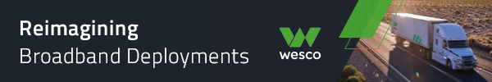
Thank you to our Fiber for Breakfast Sponsor!
Platinum Sponsor

Slide 3
2025 Regional Fiber Connect Locations
Scottsdale, Arizona - October 16 | Tribal Broadband
Kansas City, Missouri - November 11 | Demand Drivers
Contact Lucy Green (lgreen@fiberbroadband.org) for Exhibit and Sponsorship Opportunities
Notes:
Links for Chat
Fiber Connect 2025 – Save the date!
https://fiberbroadband.org/event/fiber-connect-2025/

Slide 4

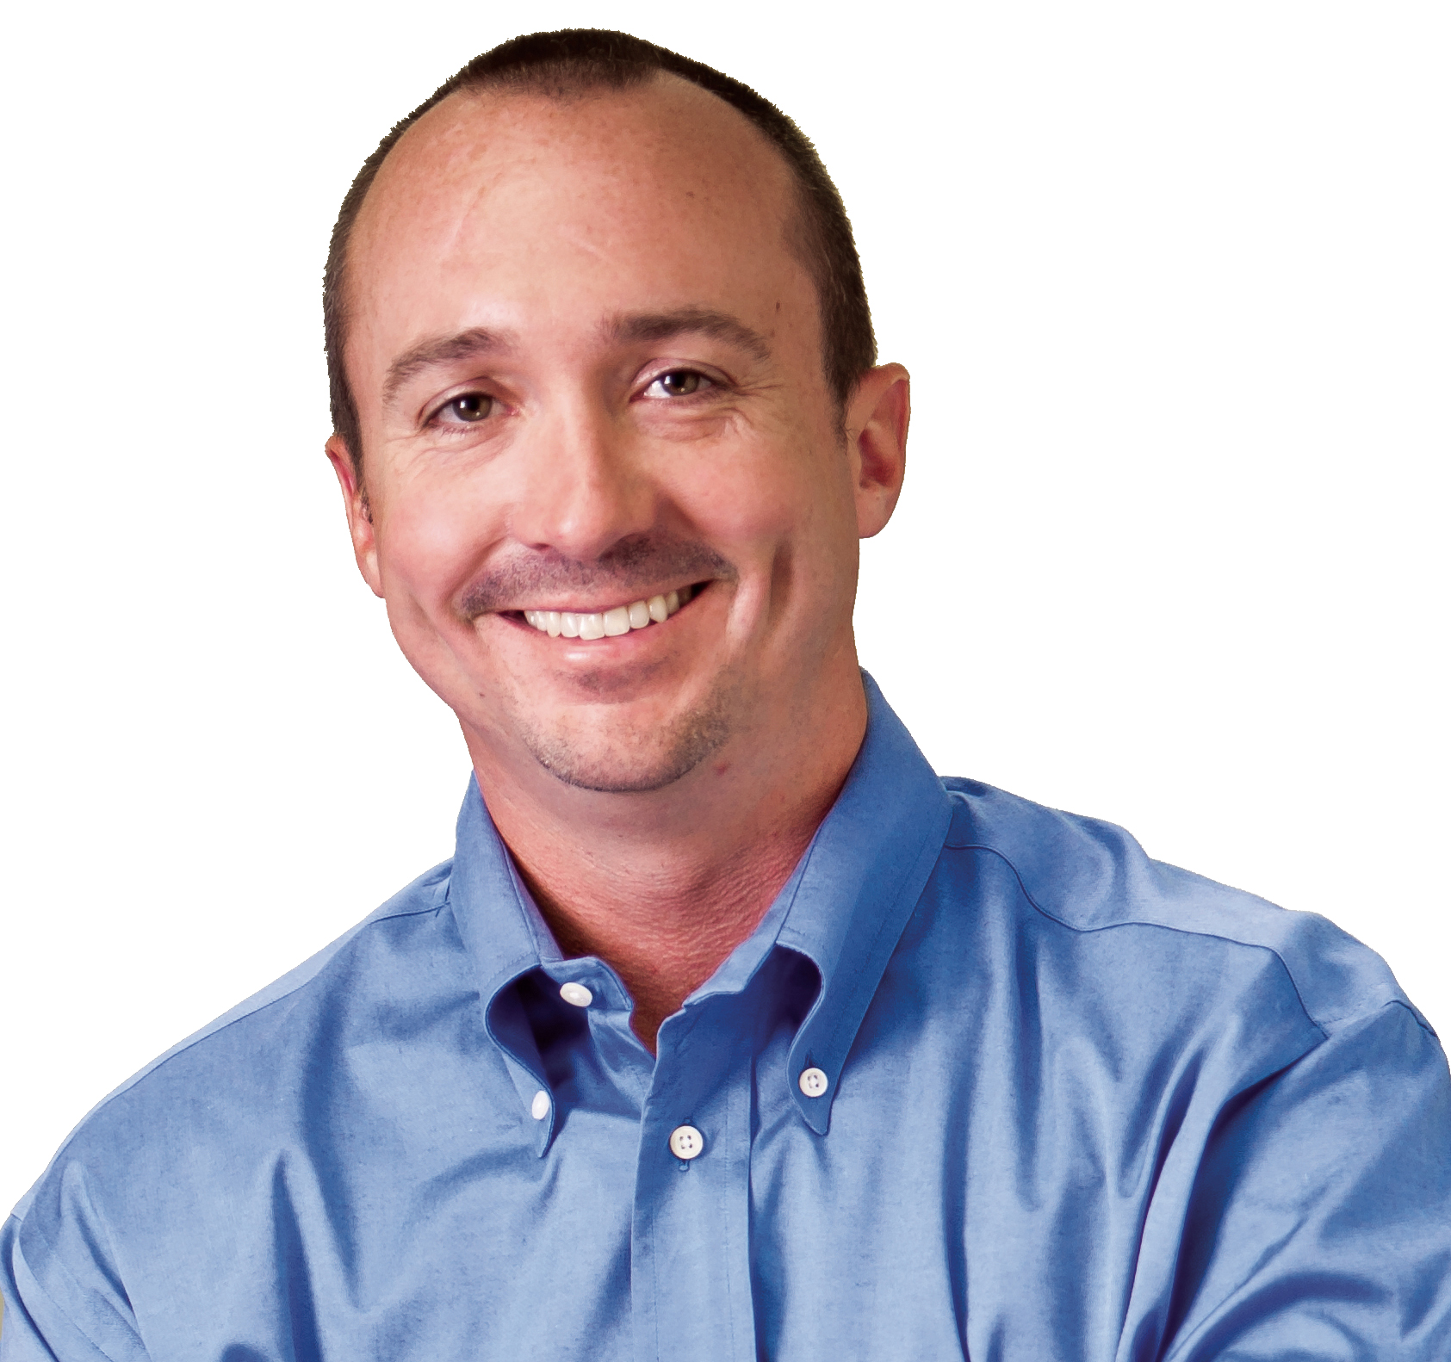
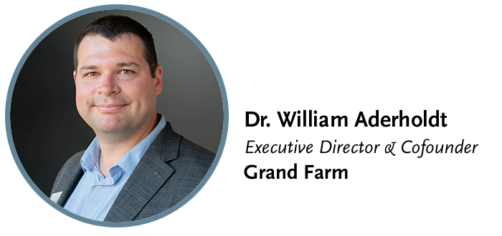

Gaurav Juneja
Chief Operating Officer

Slide 5
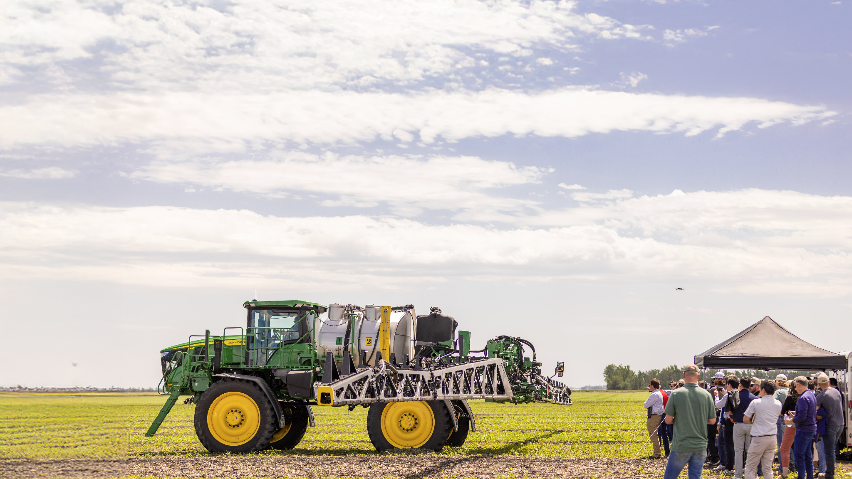

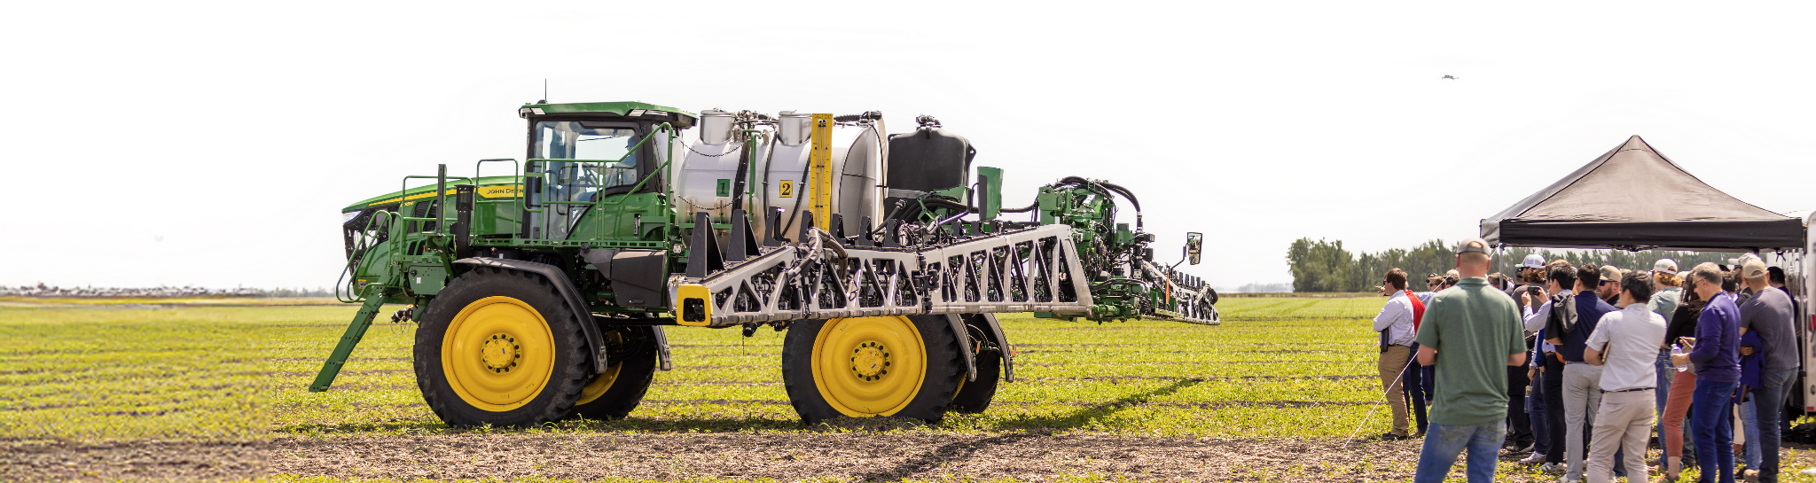

WHERE AGRICULTURE PROBLEMS MEET TECHNOLOGY SOLUTIONS

Slide 6
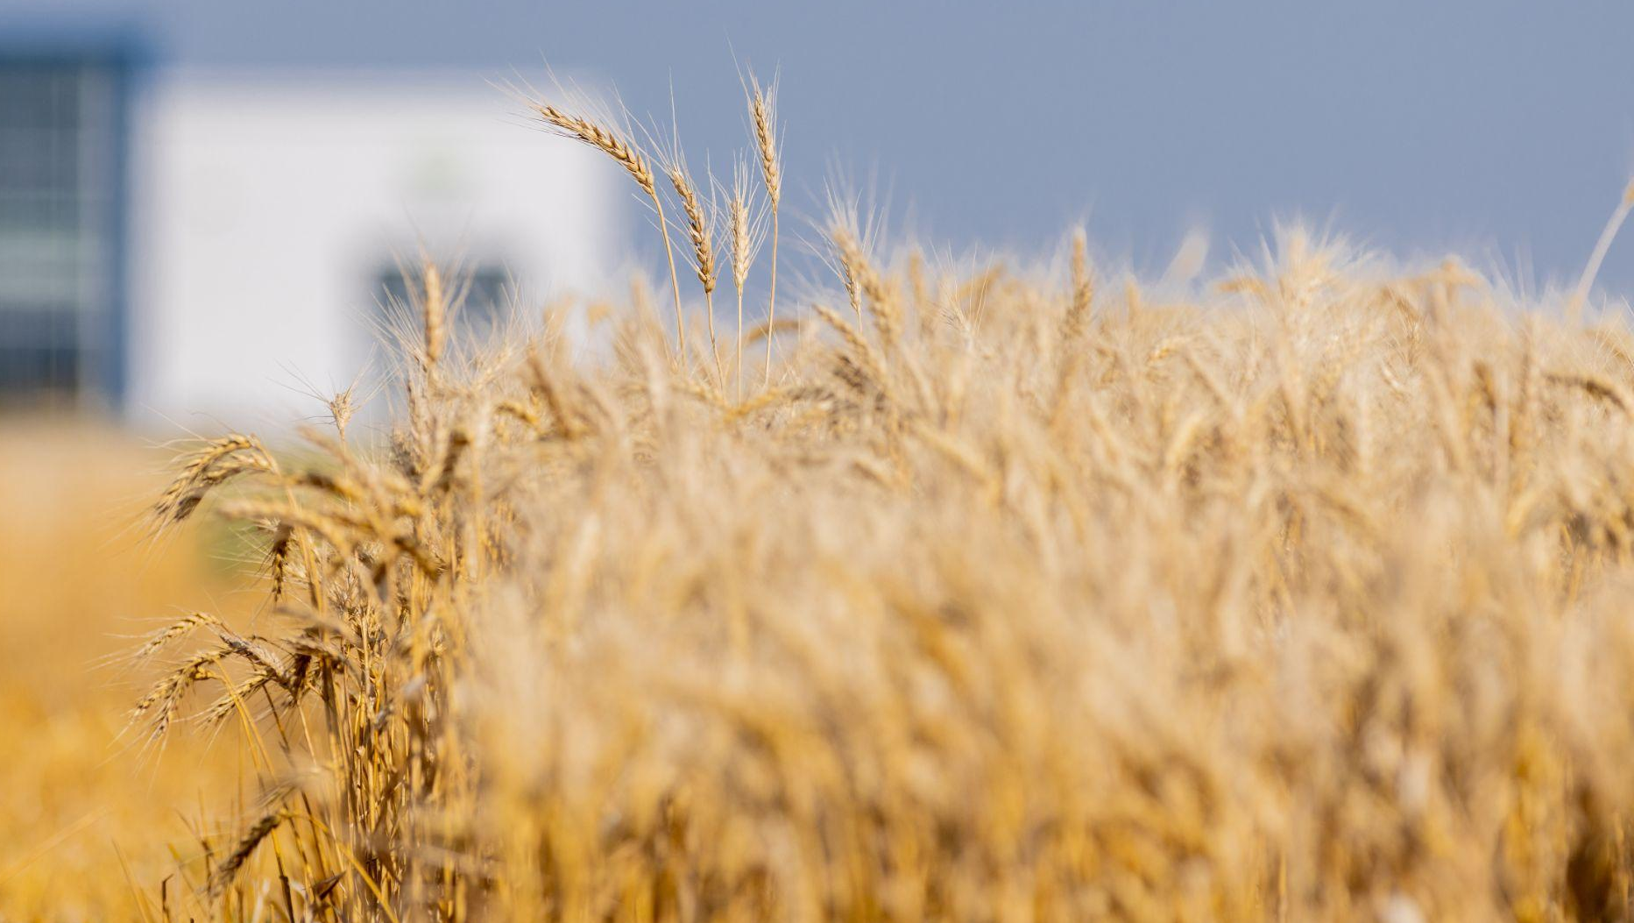


Grand Farm is a collaborative network
working together to
solve problems in agriculture
using applied technology.
OUR MISSION
GROWERS
GOVERNMENT
STARTUPS
INVESTORS
MISSION
CORPORATIONS
RESEARCHERS +
EDUCATORS

Slide 7
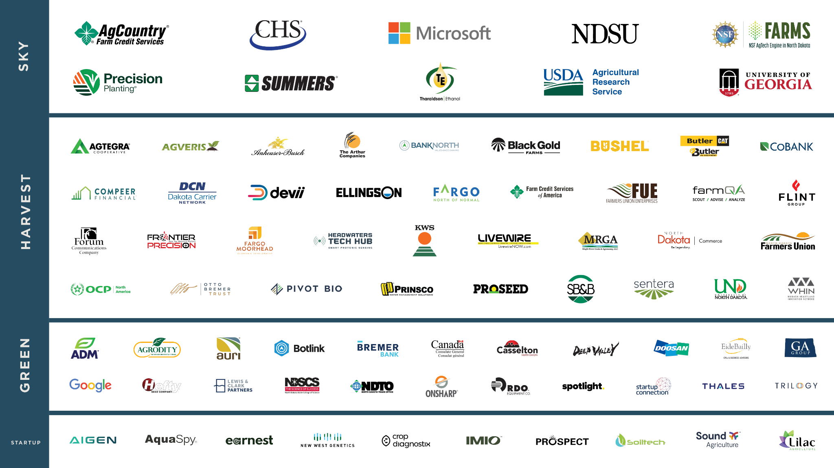
OUR PARTNERS

Slide 8



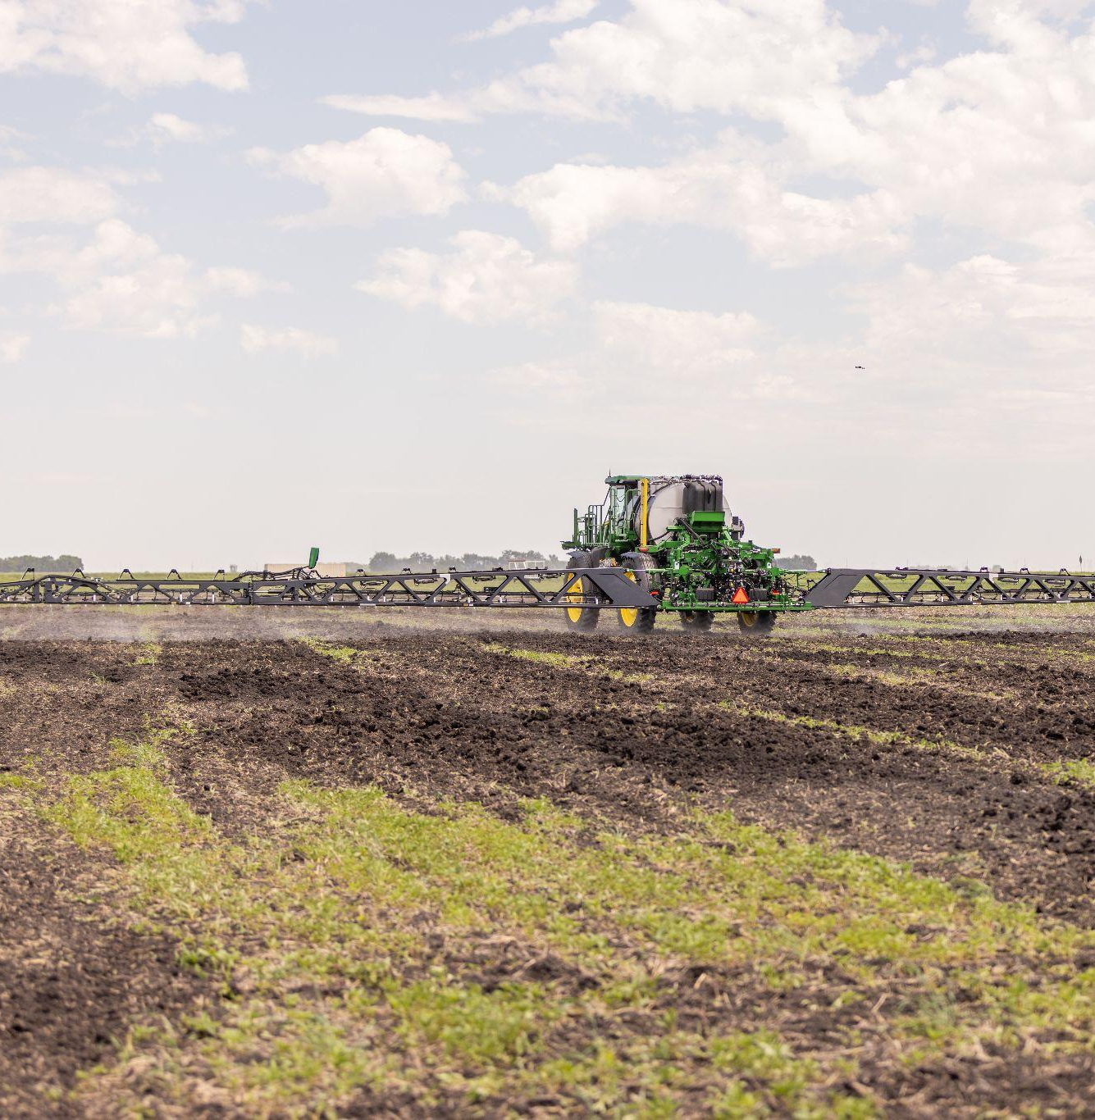
INNOVATION FRAMEWORK
IDENTIFY
CHALLENGES
UNDERSTAND
THE INNOVATION LANDSCAPE
REGIONAL
AGRICULTURE
ECOSYSTEM
1
2
GLOBAL
INNOVATION
ECOSYSTEM
WHAT DOES AGRICULTURE
IN YOUR REGION NEED?
WHERE CAN THESE
INNOVATIONS COME FROM?
What challenge in agriculture can we help you solve?
Who in the AgTech ecosystem would be valuable for you to connect with?
EXPLORE AND
APPLY PRACTICAL INNOVATIONS
3
INNOVATION FRAMEWORK
FORM COLLABORATIONS
HOW ARE INNOVATIONS
TESTED AND VALIDATED?
How can we help you test and implement your innovations?

Slide 9

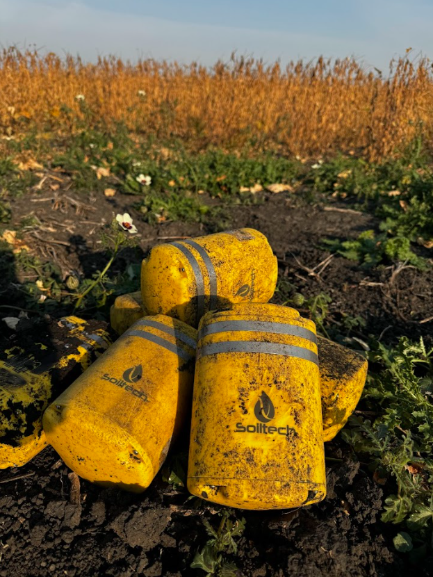
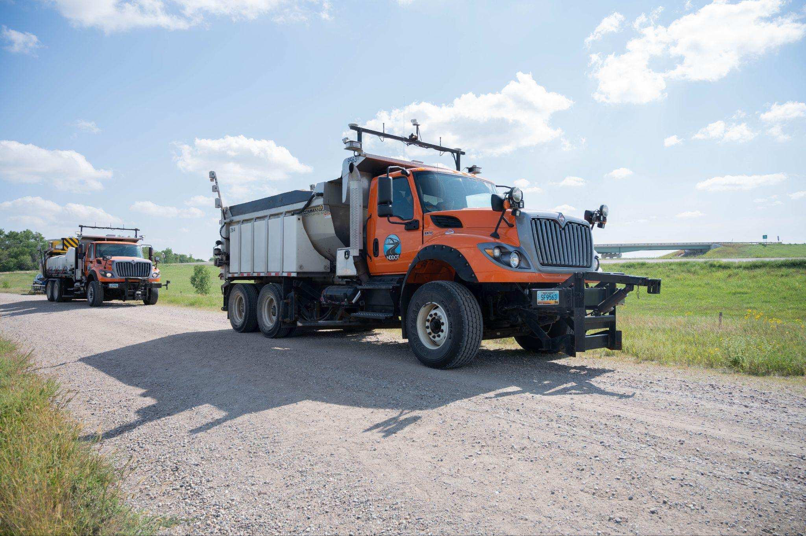
EXAMPLE: IOT PROJECT
GOVERNMENT
RESEARCHERS/EDUCATORS
STARTUPS
THE CHALLENGE
USDA ARS Lincoln needs to modernize data capture and standardize IoT systems to streamline agricultural research while ensuring compliance with evolving federal policies.
WHAT’S BEEN ACCOMPLISHED
In year one, Grand Farm focused on identifying companies, startups, and researchers developing sensor solutions, compiling key information to support USDA ARS Lincoln’s efforts in data standardization and automation.
Testing and validation work continues in year two, generating actionable insights on utilization of sensors in-field and working with researchers and participating farms.
INNOVATION FRAMEWORK
BY THE NUMBERS: The project successfully identified approximately 200 sensors tailored for AgTech use cases.

Slide 10
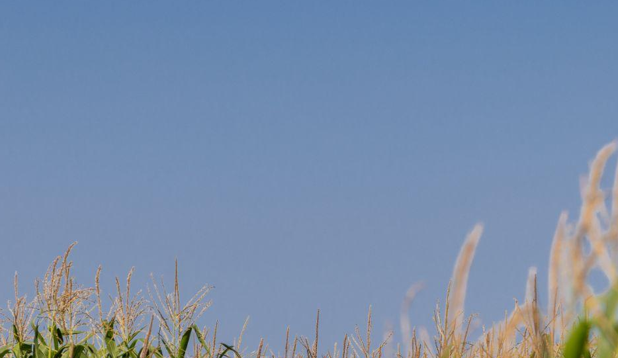

LEARN MORE AT GRANDFARM.COM

Slide 11
UP NEXT
Fiber for Breakfast Week 41
Wednesday, October 8th, 2025, at 10 AM Eastern
How Speedtest Measurements are Designed to
Improve End User Experiences
With Special Guest:
Bryan Darr
Vice President, Government Affairs
Ookla
Register for upcoming episodes and view recordings (FBA members only) on the Fiber for Breakfast page on the Events tab of the FBA website.
For information about FBA, contact membership@fiberbroadband.org.
Notes:
Links for chat:
Don’t miss out on next week’s Fiber for Breakfast!
Fiber for Breakfast Series Registration: Opt-In for 2024 Season – Fiber Broadband Association

