Slide 1
Signals of Change:
How Fiber is Continuing to Transform Kansas
Episode 45

Slide 2

Thank you to our Fiber for Breakfast Sponsor!
Platinum Sponsor

Slide 3
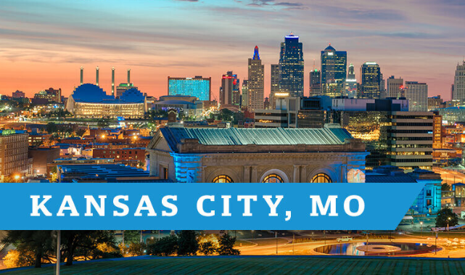
2025 Regional Fiber Connect Locations
Kansas City, Missouri November 11 Demand Drivers
Contact Lucy Green (lgreen@fiberbroadband.org) for Exhibit and Sponsorship Opportunities
Notes:
Thank you for attending today and thank you to . . .
Mike and Imtiaz, and Panduit for sponsoring today’s webinar.
Before we wrap up I want to share a few quick announcements.
Our next Regional Fiber Connect will take place on October 16th in Scottsdale, Arizona. Followed by Kansas City, Missouri on November 11th.
If you are local to either area, please join us. Follow the link in the resources tool for more information and registration details.

Slide 4

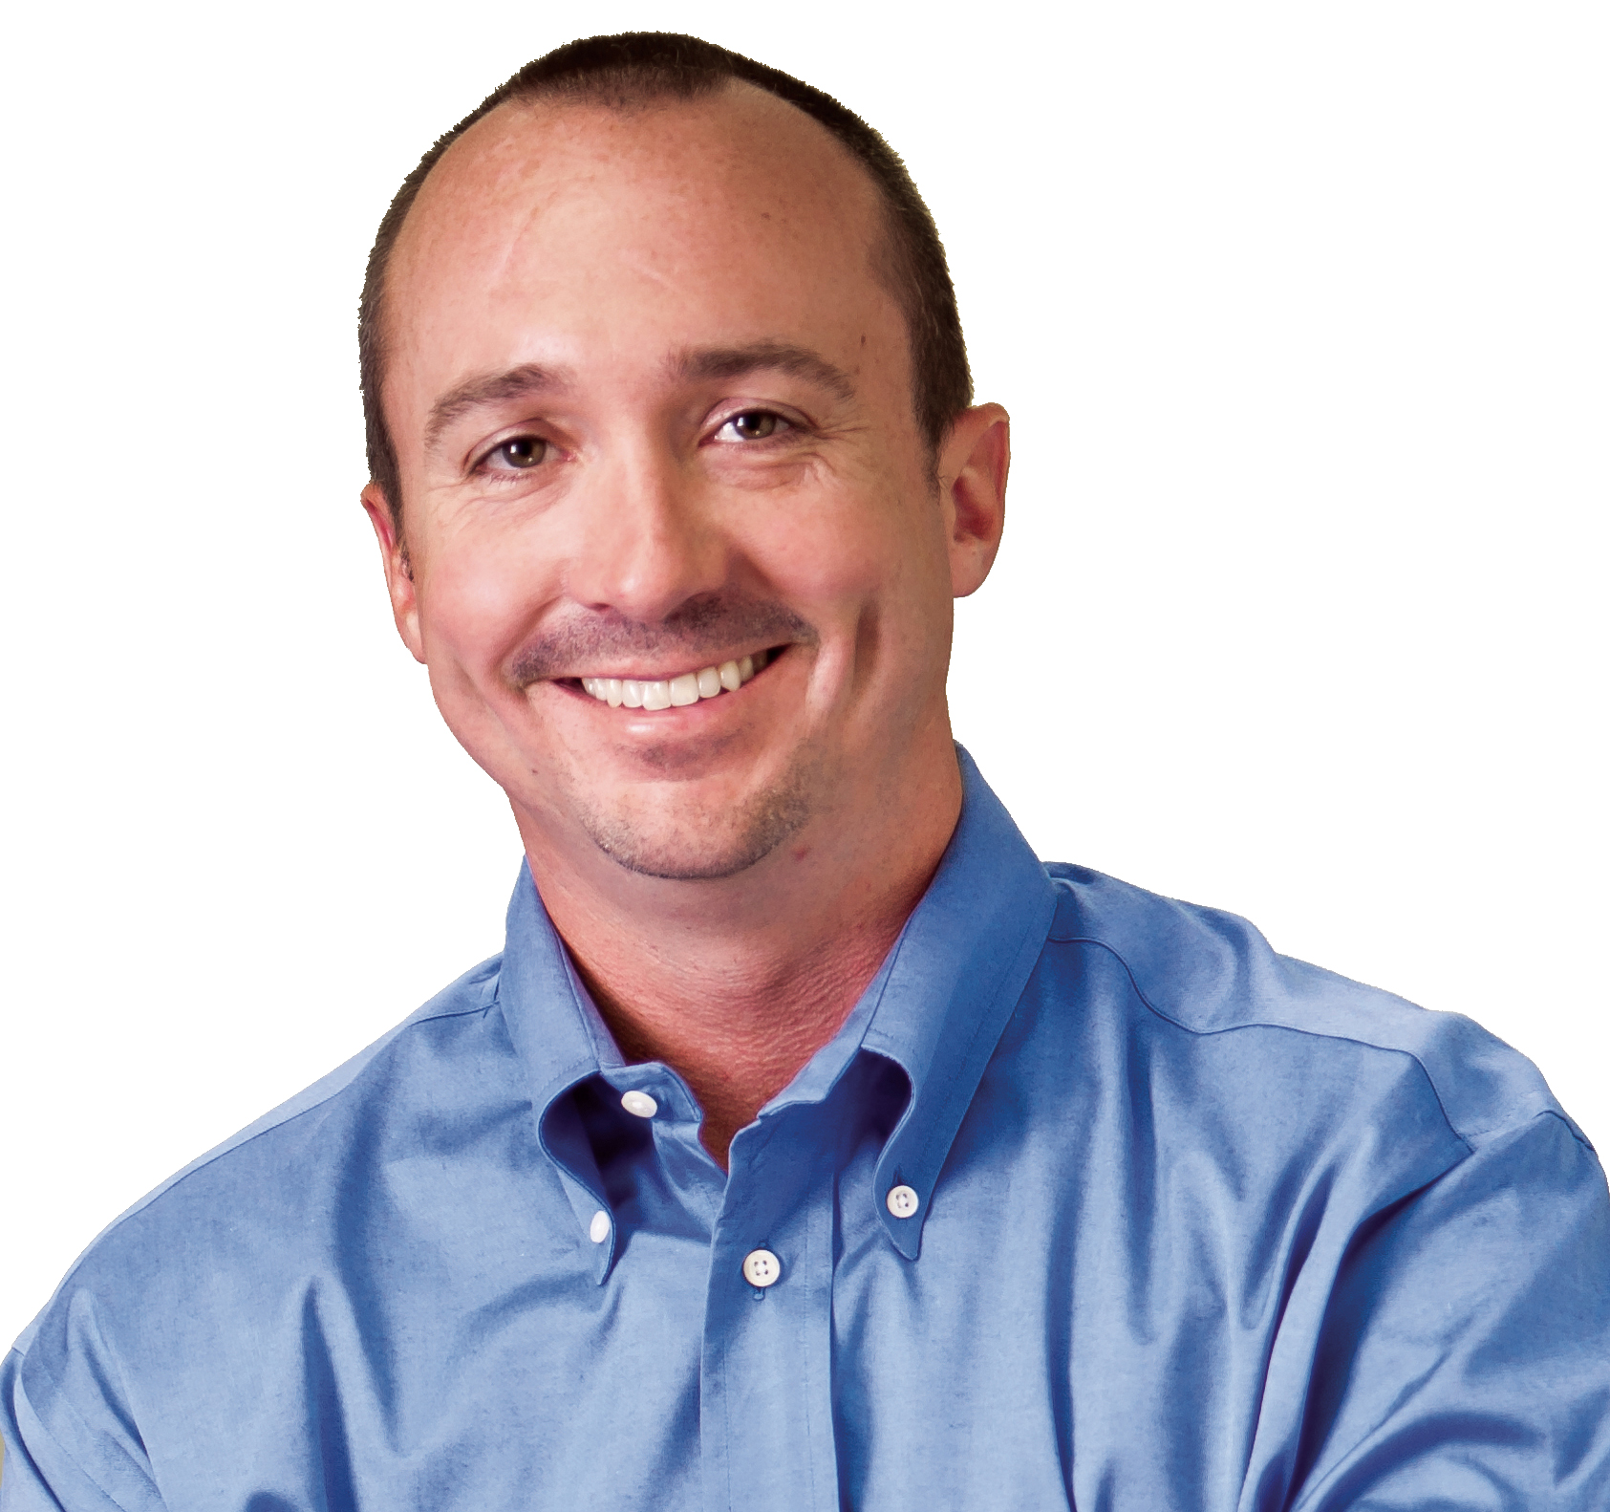
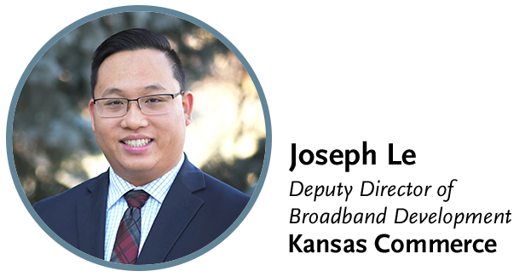

Gaurav Juneja
Chief Operating Officer

Slide 5





Established in 2020, KOBD ensures all Kansans have the opportunity to live, work, learn, and compete in a global economy by improving universal access to quality, affordable, and reliable broadband.
8
81
Current Programs
Current Projects
$158.5
137
Current Funds Invested
Projects Awarded

Slide 6
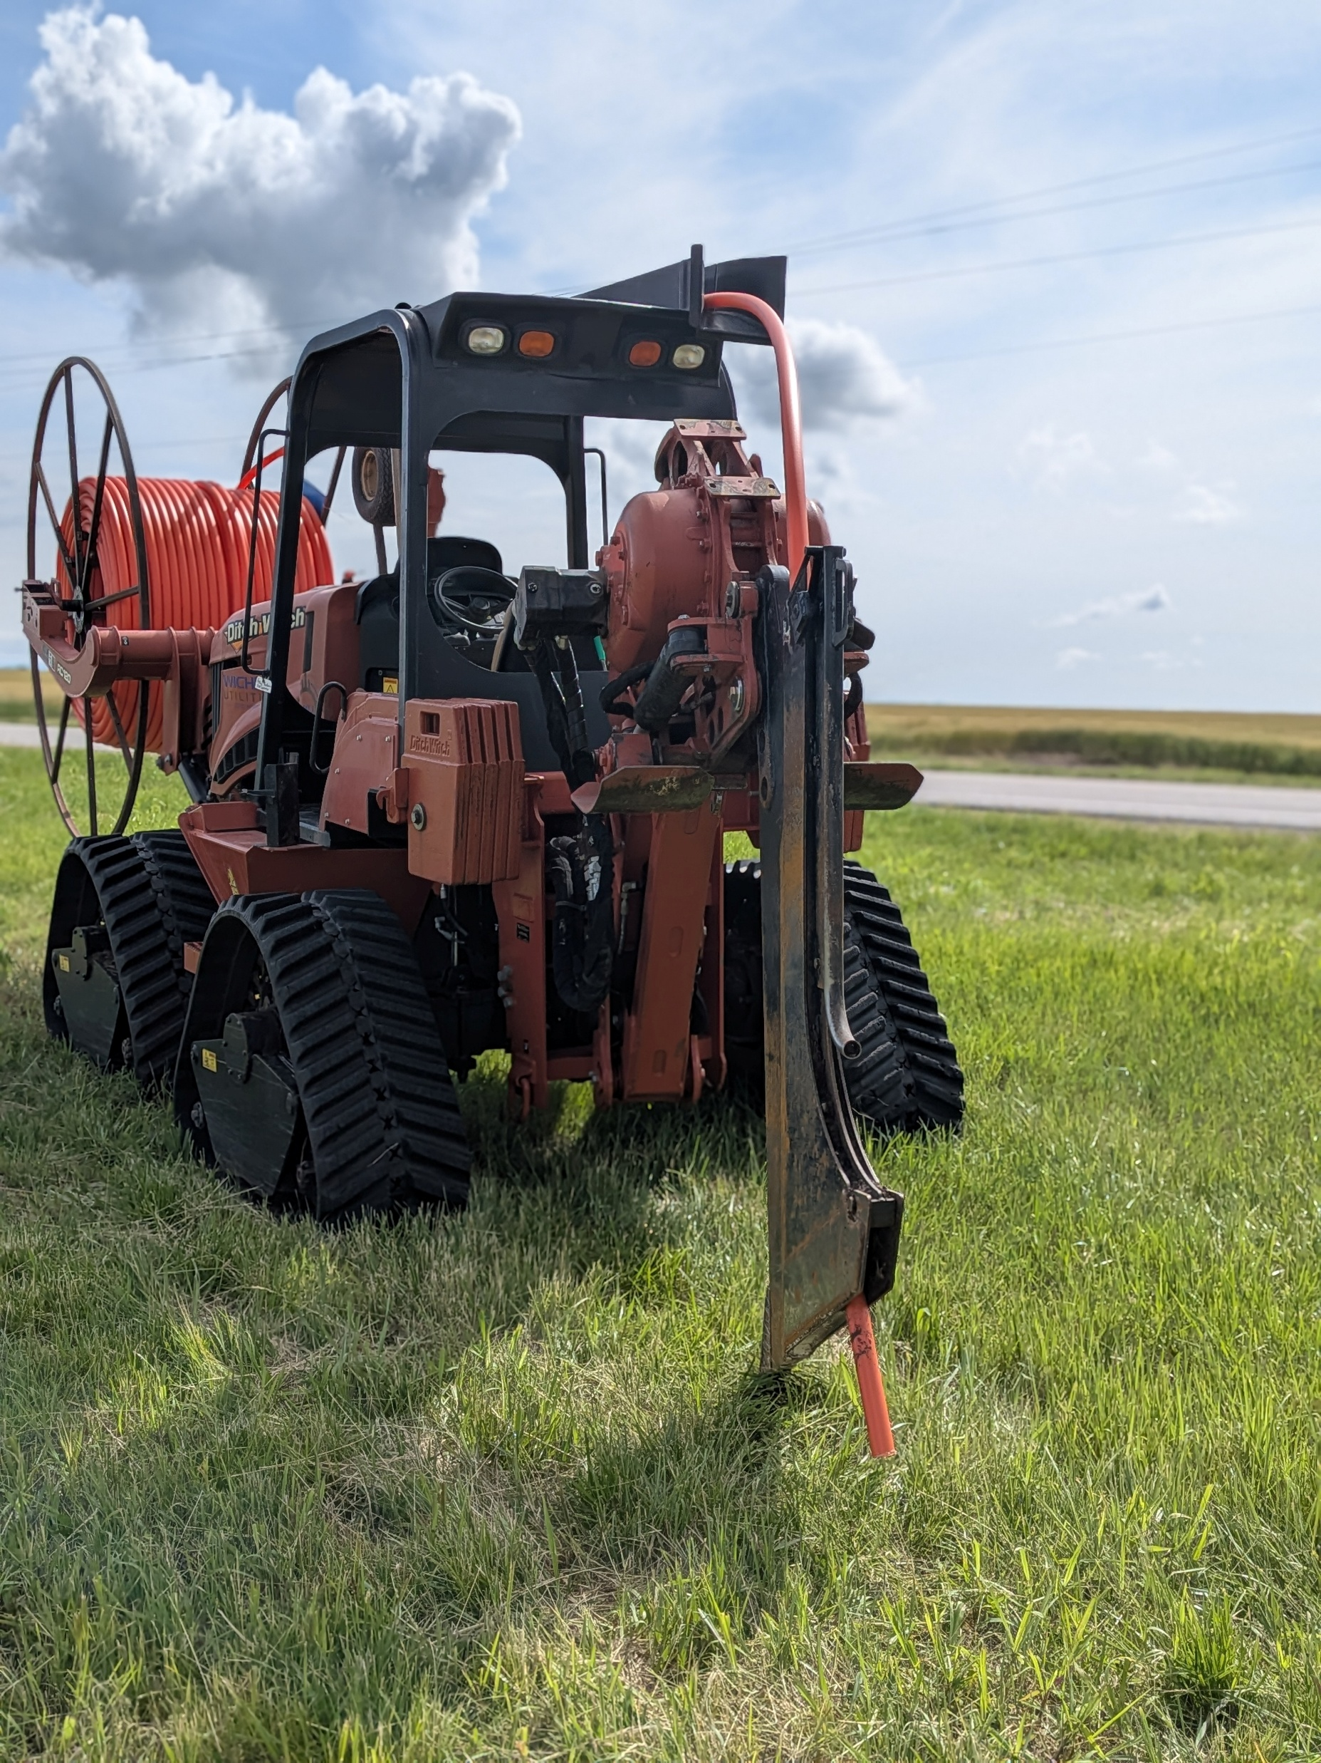



Capital Projects Fund (CPF)
This program is federally funded through the American Rescue Plan Act Capital Projects Fund (ARPA CPF) with a focus on broadband infrastructure. Commerce awarded 24 projects in late 2022 and early 2023. Construction has been completed on these projects.
$83.5M
$41.8M
25,567
Federal Investment
Matching Funds
Homes or Businesses
to be Served

Slide 7
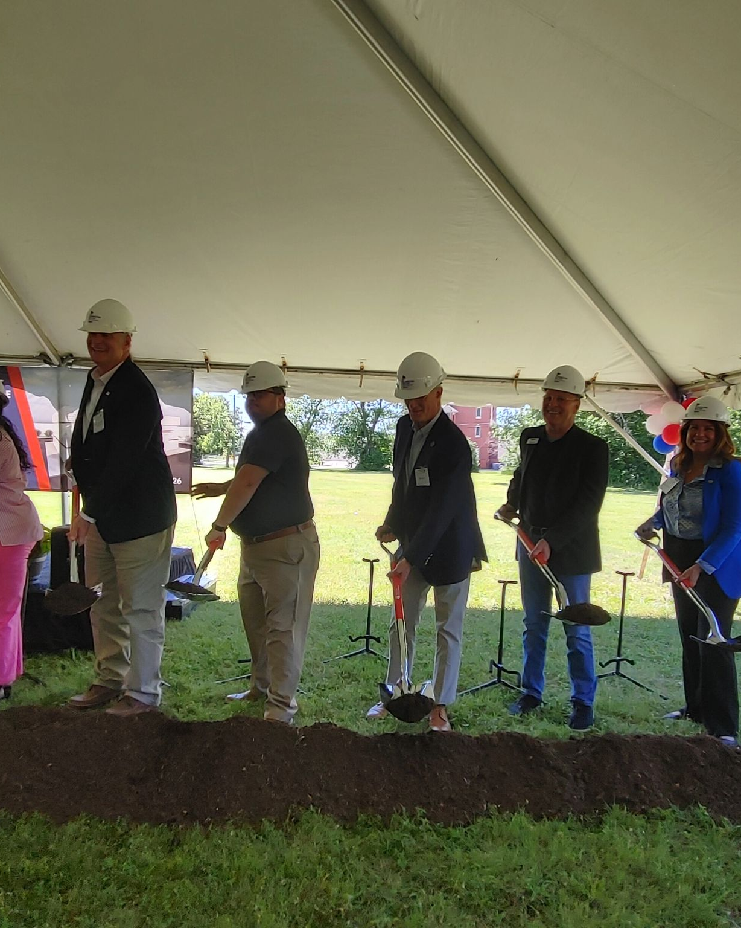
Lasting Infrastructure and Network Connectivity (LINC)
This program was created by the SPARK committee using American Rescue Plan Act (ARPA) funding. The funding supported infrastructure development including last mile, middle mile, and Internet Exchange Point (IXP) projects.
$30M
$8.2M
2,498
Federal Investment
Matching Funds
Homes or Businesses
to be Served

Slide 8
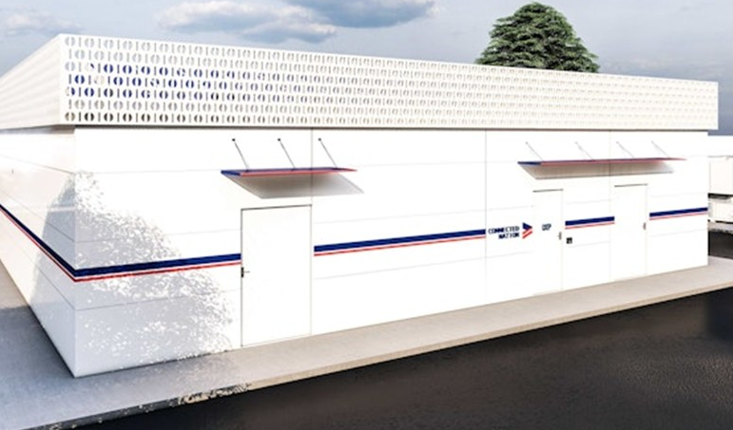
Kansas’ First Carrier-Neutral Internet Exchange Point
Lasting Infrastructure and Network Connectivity (LINC)
Facility will be located on Wichita State University’s campus.
The project is enabled by a $5 million Kansas state grant (part of a $28.5 million broadband package).
Designed for high-performance connectivity: lowest latency, lowest cost, resilient operations with redundant power and modular expansion.

Slide 9
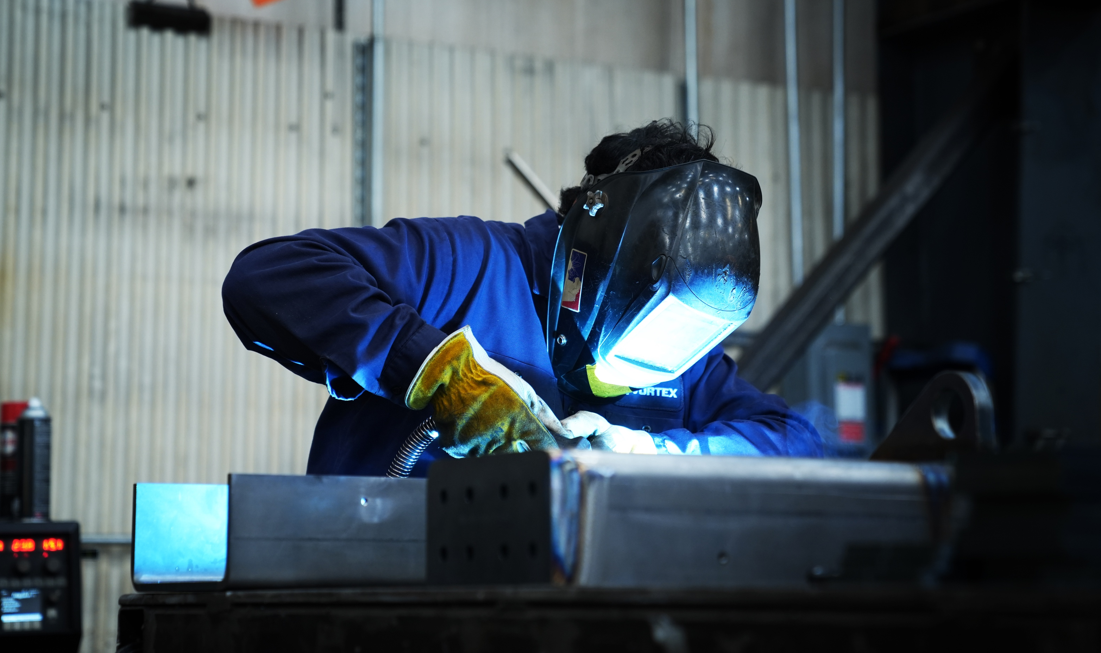

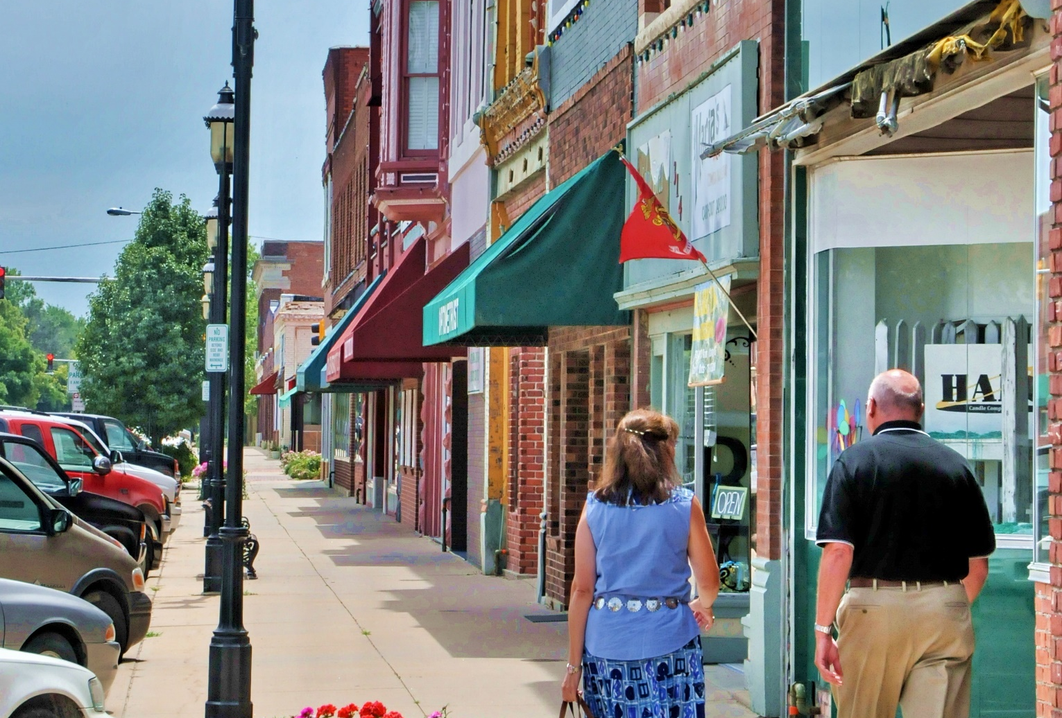
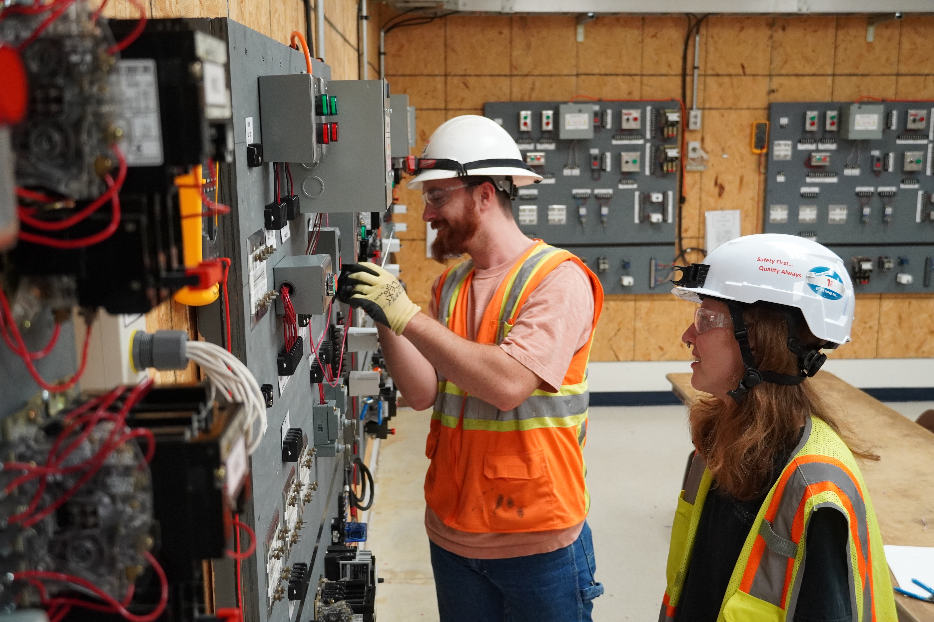
Broadband Grant Programs | Amount | Funding Entity
Broadband Acceleration Grant | $85M | State
Capital Projects Fund | $83.5M | Federal
Lasting Infrastructure and Network Connectivity | $30M | Federal
Enabling Middle Mile Broadband Infrastructure | $42.5M | Federal
Broadband Equity Access and Deployment | $451.7M | Federal
USDA: Broadband Technical Assistance | $1M | Federal
Digital Opportunities to Connect Kansans | $5M | Federal
Advancing Digital Opportunities to Connect Kansans | $15M | Federal
Developing Online Opportunities and Ready Skills | $8.2M | Federal

Slide 10
UP NEXT
Fiber for Breakfast Week 46
Wednesday, November 12th, 2025, at 10 AM Eastern
A Practitioner’s Guide to Rural Digital Inclusion
With Special Guests:
Amanda Weinstein, Ph.D.
Director of Research, Knowledge & Evaluation
The Center on Rural Innovation (CORI)
Shaniqua Corley-Moore
Head of Tech Talent Development
The Center on Rural Innovation (CORI)
Register for upcoming episodes and view recordings (FBA members only) on the Fiber for Breakfast page on the Events tab of the FBA website.
For information about FBA, contact membership@fiberbroadband.org.
Notes:
Links for chat:
Don’t miss out on next week’s Fiber for Breakfast!
Fiber for Breakfast Series Registration: Opt-In for 2024 Season – Fiber Broadband Association

