Slide 1
An Update on
Broadband Development
The Arkansas State Broadband Office BEAD Program
and the Road to 2027 Construction
Fiber Broadband Association
Fiber for Breakfast
October 7, 2026

Slide 2
Established in 2019
Eight full-time staff positions – all federally funded
Background
The Arkansas State Broadband Office (ARConnect) was established in 2019 and has awarded over $800MM in grants, to date.
Awarded $826MM
298 projects covering 205,000 homes and businesses
167 Projects Completed
Covering 124,000 homes and businesses

Slide 3
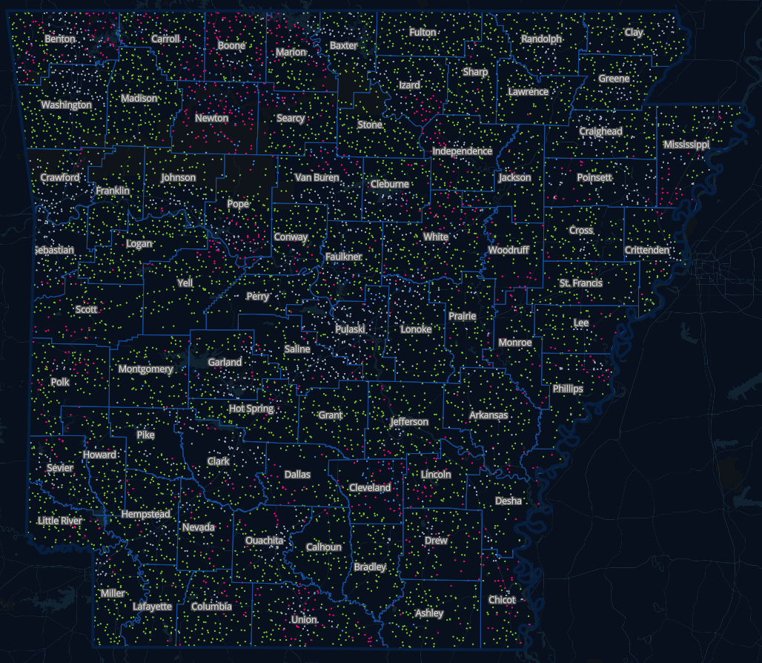
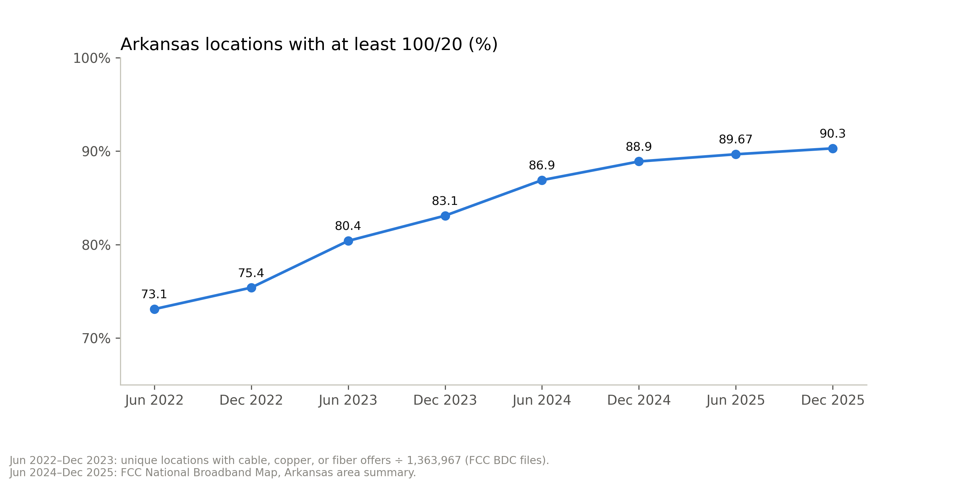
Current State of Connectivity
Total Locations in Arkansas
~1,360,000
Homes, businesses, and community anchor institutions

Slide 4
The BEAD Program

Slide 5
Did you know?
The Arkansas BEAD Program represents the single largest investment in broadband infrastructure in the state’s history.

Slide 6
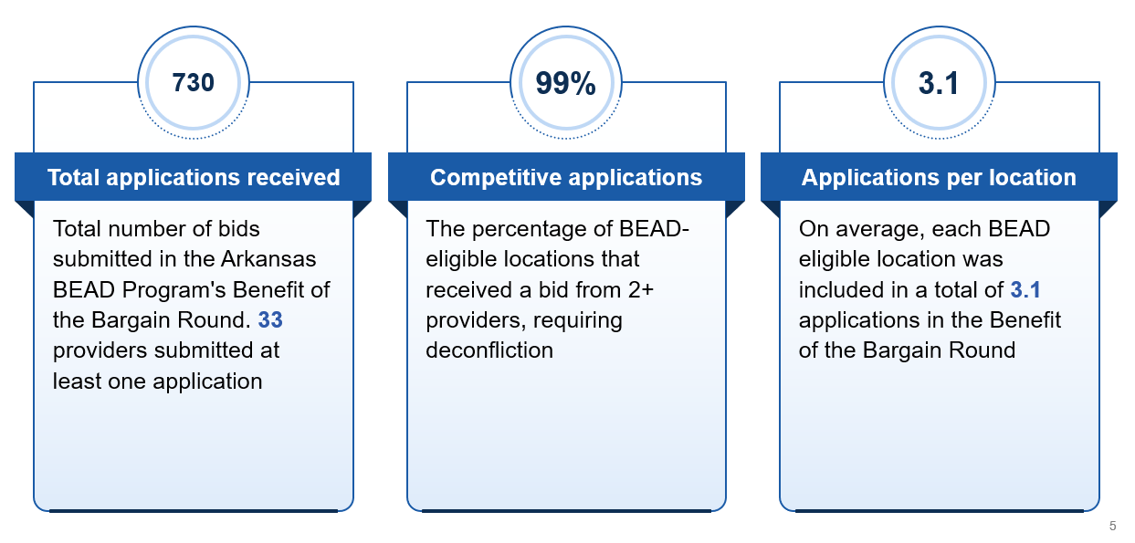
BEAD Program Results: Highly Competitive

Slide 7
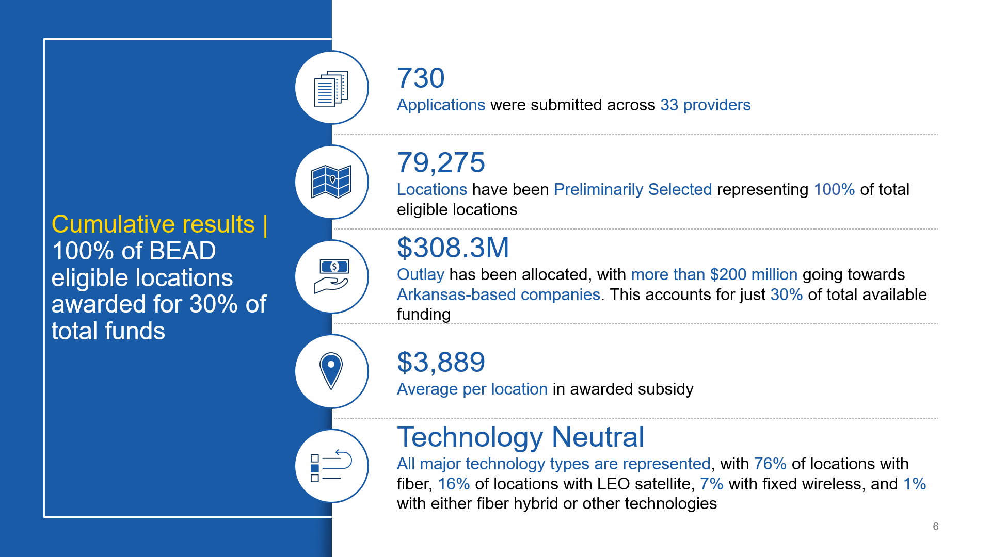
77,514
$299.6 Million
$3,865

Slide 8
BEAD Immediate Timeline*
Activity/Milestone | Target Date(s)
U.S. Department of Commerce Review: NTIA & NIST | Complete
Arkansas Legislative Council (ALC) Appropriation Approval | Complete
Execute Grant Agreements Prospective subgrantees must meet all grant agreement requirements | Complete
Complete Project Environmental/NHP Review | Q4 2026 / Q1 2027 (Estimate)
Construction Can Begin | Q4 2026 / Q1 2027 (Estimate)
*Tentative and subject to change. Not all activities are necessarily listed in the table.

Slide 9

broadband.arkansas.gov
broadband@arkansas.gov
@ARConnectASBO
(501) 683-6000

